Slide 1
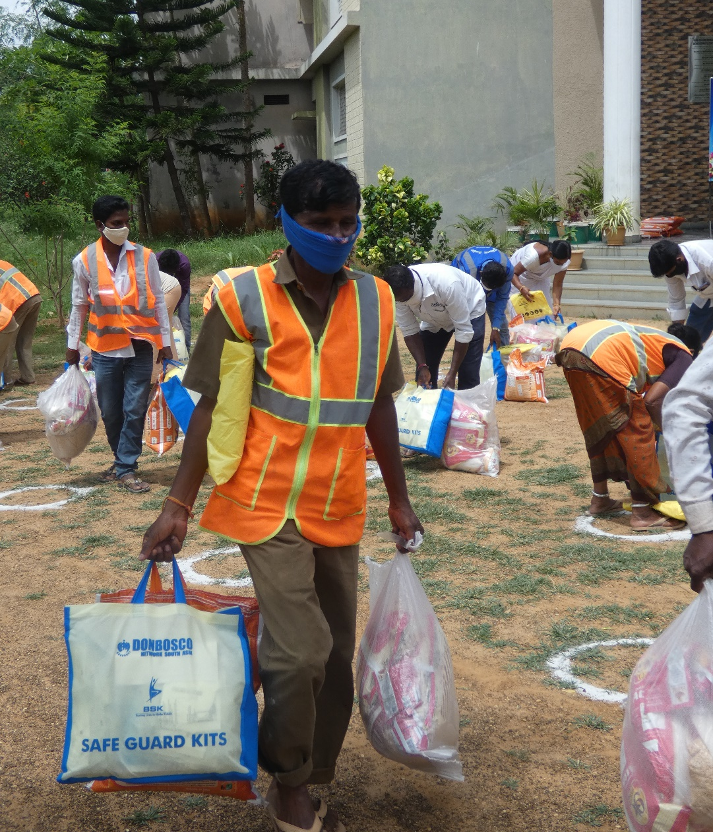
Annual Report: 2021-2022
Bosco Seva Kendra, Hyderabad, India

Slide 2
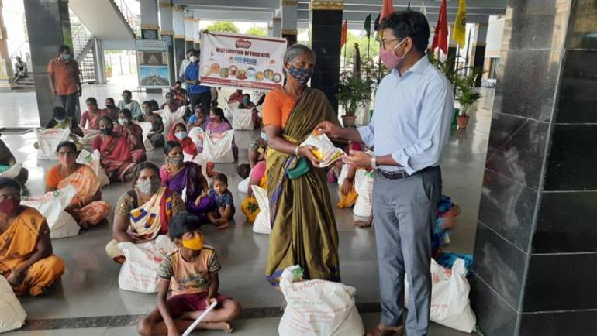
Chairman’s Message
Pictured on the right, Fr. Thathireddy Vijaya Bhaskar SDB, Chairman of Bosco Seva Kendra, distributing food packages to poor women and youth in Hyderabad.
Dear Readers
Bosco Seva Kendra serves as the Planning and Development Office of the Salesian Province of St. Joseph, Hyderabad. The office plays an integral role in supporting charitable efforts undertaken by Don Bosco Institutions in Andhra Pradesh, Telangana, and south Odisha. This year, in light of an ongoing pandemic and the recent floods that have devastated our region, we can witness and see how fragile life can be. These unprecedented events have taken away certain securities we took for granted. Millions of families in our region and around the world have lost their livelihoods, and face an uncertain future.
In spite of such challenges, our organization, Bosco Seva Kendra, has been on the frontlines providing food, medical essentials, and supporting those who have been impacted by the pandemic. We have helped close to 900,000 poor persons over the past 2 years and continue to do so today. Apart from these activities, our organization supports a network of 32 Don Bosco Institutions that provide education, skill training, and youth services for poor children and youth who lack access to education and struggle to make ends meet.
We are able to undertake such activities thanks to the help and generosity of our donors. Despite our best efforts tens of thousands of poor children, youth and families suffer from various grave hardships and challenges. Our organization and Province exists to provide an alternative to a life of grave hardships and we need your help to continue our efforts.
Sincerely,
Fr. Thathireddy Vijaya Bhaskar SDB

Slide 3
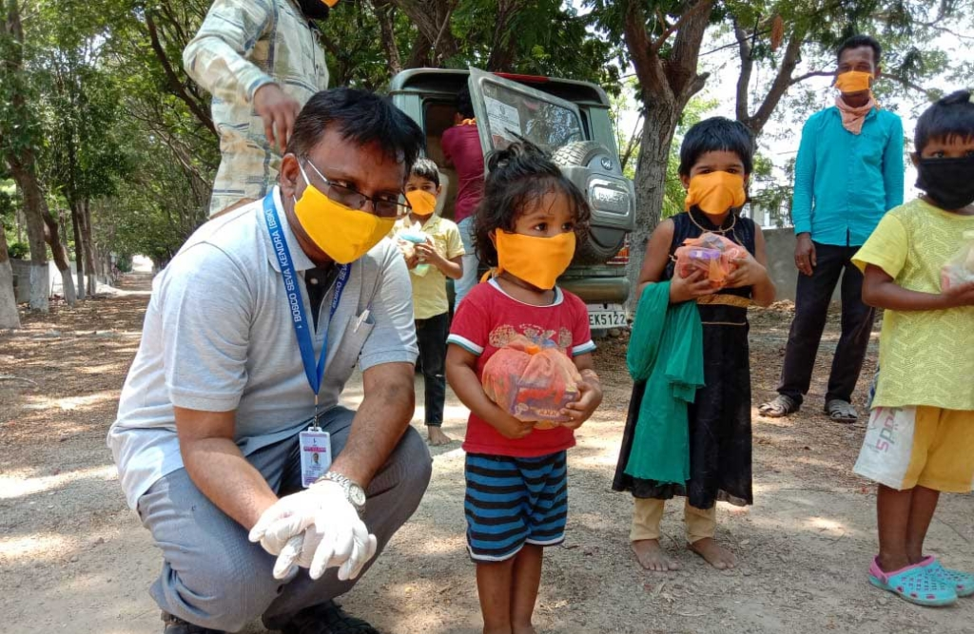
Executive Director’s Message
On the left, Fr. Sudhakar Bellamkonda SDB, distributing food package and face masks for poor children.
Dear Readers
Echoing the words of the Chairman of our organization, this Financial Year 2021/2022 has been challenging year for all of us. India is one of the main epicenters of the ongoing pandemic, we have witnessed the collapse of our healthcare system during the second wave. Despite such tragedies we are grateful for the support of our donors who have helped us distribute food, essential items and facemasks during the lockdown. The scale of the Don Bosco Network in our region, the network gives us the opportunity to support isolated communities where there is a limited presence of independent non-profits operating in these areas.
Over the past financial year, close to 900,000 people have received food packages, hand sanitizers and face masks. These essential items are essential since many families and youth in our region are unemployed and have no alternative sources of income. Despite, the ongoing pandemic, the effects of climate change and the destruction of the natural world continue to affect us. The recent flooding in Andhra Pradesh, high temperatures during the summer, and other social concerns require collective action, not abstract solutions.
Our organization has made good strides this year in bringing in donors to support our mission and network of institutions. We hope to build upon these efforts in the coming financial year. We are deeply grateful for support of our donors over the past year, we would not be able to function or be of assistance without your help.
Kind regards,
Fr. Sudhakar Bellamkonda SDB

Slide 4
Table of Content
About us 1
Our Outreach Programs 3
COVID-19
Flood Relief
Institutional Activities 5
Homes for Abandoned Children
Don Bosco Schools and Colleges Network
Don Bosco Technical Schools Network
Youth Services
Community Outreach 13
Environment Programs
Microcredit Program
Civil Society Organization Program
Our Donors 16
Going Forward 17

Slide 5
About us
Bosco Seva Kendra was established in 1993 to serve as the Planning and Development Office of the Salesian Province of St. Joseph, Hyderabad, India and support charitable activities undertaken by Don Bosco Institutions operating in Andhra Pradesh, Telangana, and south Odisha. Bosco Seva Kendra and our network of Don Bosco Institutions provide a wide variety of charitable services to all members of society regardless of ethnicity, age, gender, economic status, and religious affiliation.
Our Vision
Bosco Seva Kendra educates and capacitates the young and marginalized people through a participatory approach to achieve holistic and environmentally sustainable development.
Our Mission
The young and marginalized people are empowered, and enjoy equal rights, opportunities and healthy environment.
Our Focus Areas
Protecting the dignity and sanctity of human life
Advancing equality and integral human development
Reducing extreme poverty and promoting human flourishing
Protecting the environment
Organizational Activities
Scholarships for poor students
After school programs and youth services for poor students and youth
Rehabilitation of abandoned children and victims of domestic violence
Skill training for poor youth, unemployed youth and school dropouts
Career services and job placement for poor and unemployed youth
Environmental stewardship programs
Disaster relief programs
Microcredit Program – Economic mobility for poor women and mothers
Our Organizational Network
Bosco Seva Kendra engages with donors and charitable entities to fund organizational activities undertaken by the following institutions. The data stated above was collected in October, 2021.
Demographics of our RegionThe population of our region – Andhra Pradesh, Telangana and South Odisha is estimated to be around 91 million people. Approximately 40% of the population lives in poverty, literacy is estimated to be around 70% for adult men and 65% for women. This metric of literacy measures those who have received a primary education only. This demographic information was taken from the Government of India, Census of 2011.
Institutional Network | No. of Institutions | No. of Direct Beneficiaries
Schools and Colleges | 17 | 9,229 Students
Technical Schools | 7 | 1,765 Students
Homes for Abandoned Children | 17 | 1,670 Children and Youth
After School Programs | 120 | 3,600 Children
Safe Home for Girls and Women | 3 | 275 Girls
Microcredit Program | 19 | 10,000 Women
Career Guidance Job Placement | 1 | 4,000 Youth
COVID-19 Relief Efforts | - | 900,000+ Persons
Community Partnerships | 124 | Independent charities
1

Slide 6
UN Sustainable Development Goals 2030
Our organization works collectively with our partners to achieve the following UN Sustainable Development Goals for 2030.
Our Charitable Partners
The institutions mentioned below are our partners in development who have been with us since the very beginning.
2

Slide 7
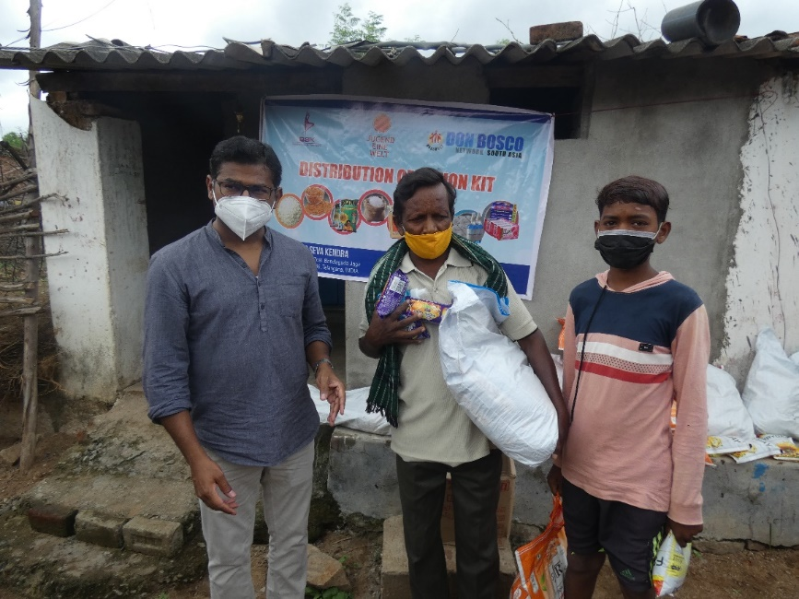
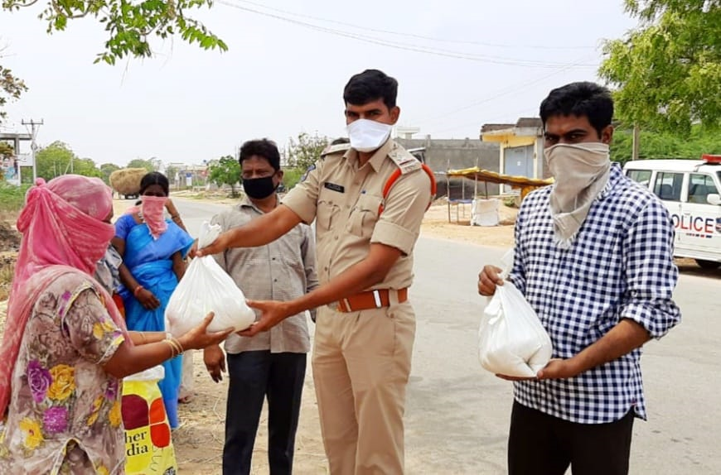
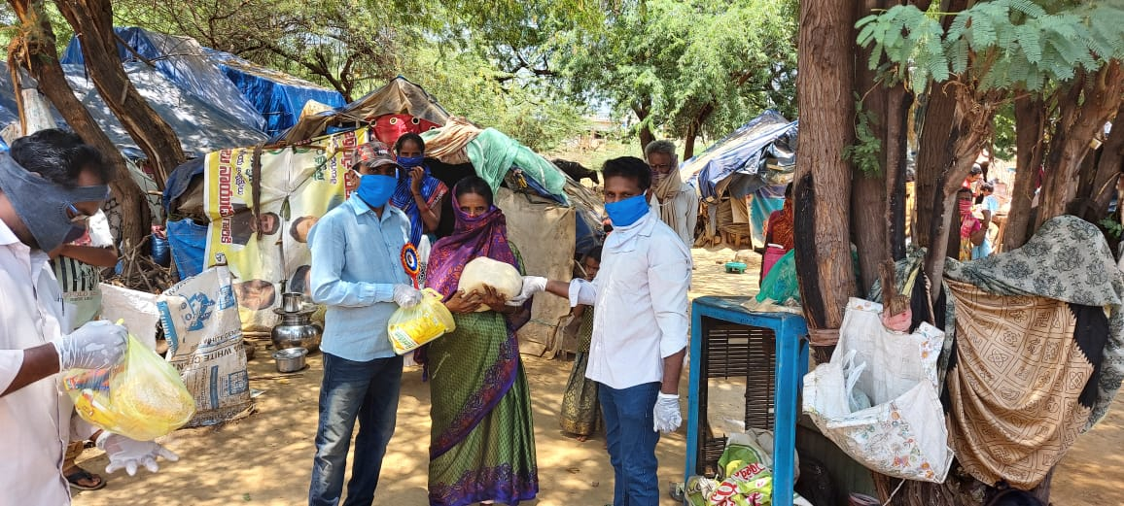
Outreach Programs: COVID-19
Since February, 2020, the ongoing pandemic has devastated our region, our organization thanks to the support of various donors has been in a fortunate position where we can undertake outreach programs to support those who have been impacted by the virus. Outlined below are the highlights of 2 years of COVID-19 relief activities.
Items | Number of Beneficiaries
Food Kits – 2 Weeks of Non-Perishable Groceries | 450,000 Food Packages
Sanitary Napkins | 8,150 Packages
Hand Sanitizers | 90,000 Packages
Soaps | 51,202 Packages
PPE Kits for Essential and Frontline Workers | 904 Kits
Food Packages for Migrants | 86,135 Persons
Fruits | 10,500 Fruit Packages
Food for Street Children | 42,039 Children
Nutritional Biscuits | 45,071 Packets
Financial Support for Poor Families | 811 Students
Distribution of Food Kits in Poor Communities and Rural Areas
3

Slide 8
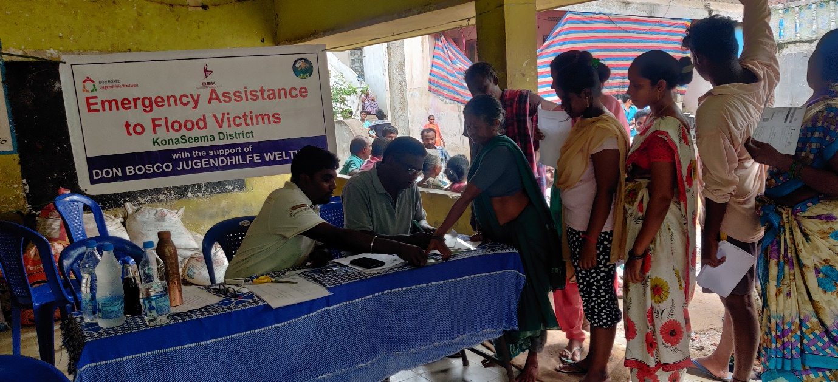
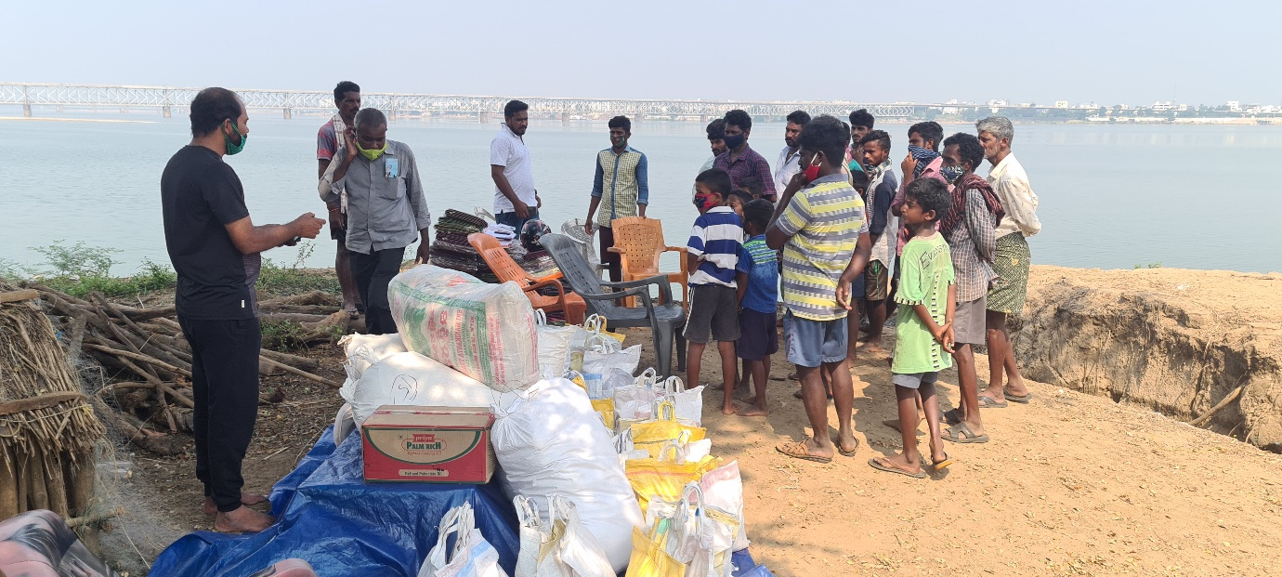
Flood Relief Activities
Apart from COVID-19 relief programs, our organization was able to mobilize to help poor families who had lost their farmland and homes due to heavy flooding during the months of August, September and November of 2021. We were able to provide over 1,500 families with food packages and health essentials.
We were able to conduct these programs that to the support of the local police, government administrators and village leaders. Northern Andhra Pradesh is one of the main agricultural centers in India. Flooding in this region will undermine the economic livelihood for the coming year. We are deeply grateful for several donors who came forward to support this program despite the uncertain economic times we live in.
We sincerely hope that donors will continue to support us in providing relief, assistance and support to these families. Farmers in our region are heavily dependent on good weather conditions to support their families. Loss of crops undermines the stability of families and farming communities across the region.
Pictured above, registration of families seeking food packages and relief items.
Distribution of food and relief items with our partners.
4

Slide 9
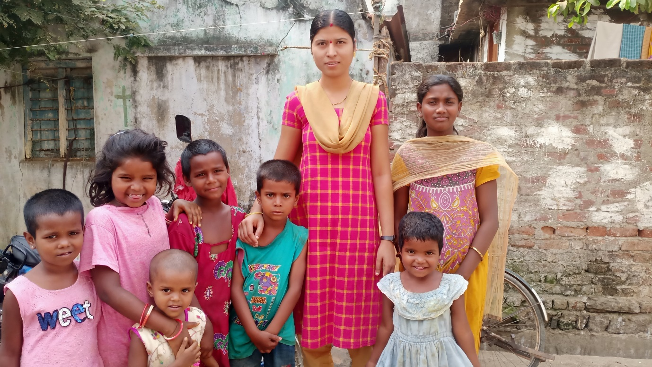
Institutional Activities
Outlined below are the various activities we have undertaken to support our institutional network.
Homes for Abandoned Children
Our wider organization operates 17 homes for abandoned children in our region. In total over 1,600 children benefit from this network. Children residing in these campuses are provided housing, primary healthcare, counselling, enrolment into government schools, personalized academic support, and counselling.
All children residing in these homes are above the age of 6 and have been registered with the local police and various government entities responsible for child care and protection. Outlined below are activities we as an organization have conducted to support this network.
Warangal Street Children Program, Warangal, Telangana
Warangal Street Children Program
In recent years, our organization with the support of a major donor has been able to provide a wide variety of day care services for children living in slum areas in Warangal. The day care program provides very poor children with regular meals, primary healthcare, academic support, counselling and enrolment services for government schools in the area. Every day 50 slum children visit our center and receive personalized care and assistance. These children come from the households where their parents have not received a formal education and suffer from food insecurity.
The day care programs provides children an escape from the hardships and challenges they face at home. This program is conducted in an integrated building that is owned by our organization opposite the main railway station of Warangal. With the suspension of schools in Warangal, this center became a lifeline for parents who could not support the education of their children. Furthermore, providing these children with food security ensures that they are able to grow up and live a dignified life.
5

Slide 10
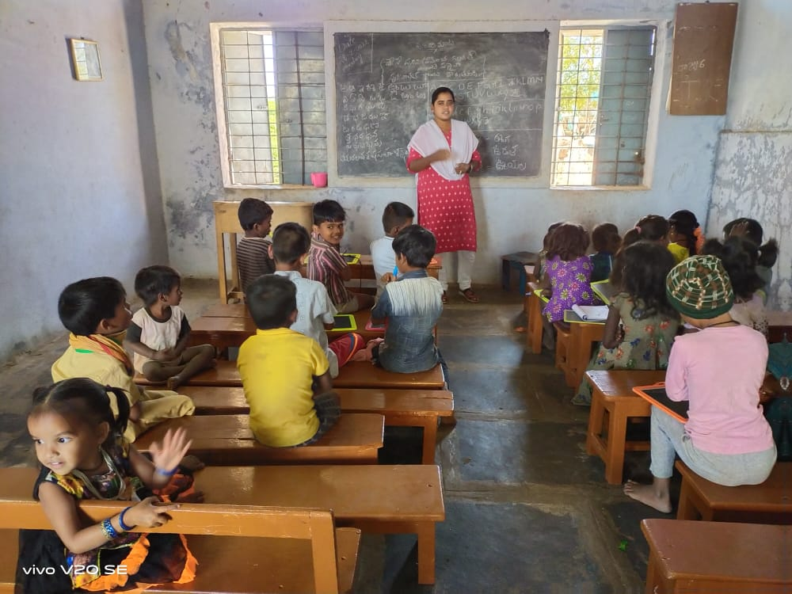
Shikari Project
The Shikari Project is an outreach program to help children and poor mothers who belong to the Shikari Tribe. This tribal community originates from Central India and have migrated into Kurnool, Andhra Pradesh, in hopes of finding better employment and opportunities for their families and their wider community. Over the past several years, our organization has been able to provide regular meals, primary healthcare, enrolment services into government schools, academic assistance and skill training programs in tailoring for mothers and children of the Shikari Community.
This year we were grateful to have received financial assistance from a major donor to continue this initiative for the coming 3 years. Over 50 children and their families receive direct care and assistance from our organization. Our organization operates a home that rehabilitates abandoned children in the heart of Kurnool, Andhra Pradesh. This campus hosts children and mothers of the Shikari Community throughout the year. The campus provides these families with various personalised support services. Our goal is to help restore dignity, purpose and reduce child neglect for children and families who belong to this community. We sincerely hope that readers will see the value of this program and support us in our efforts.
.
6

Slide 11
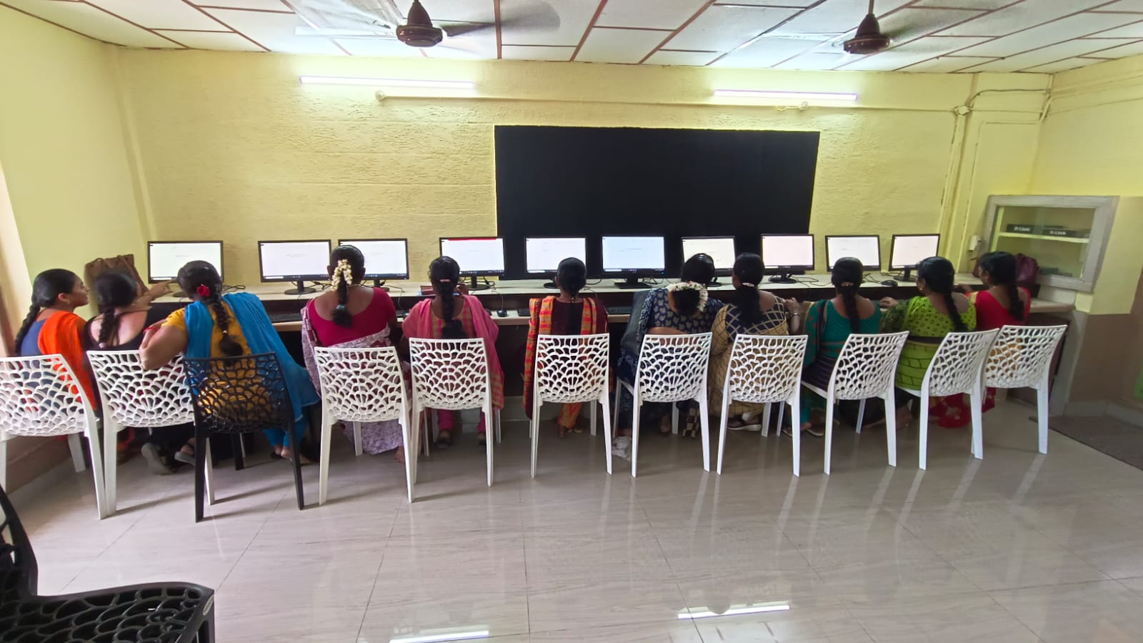
Don Bosco Schools and Colleges
Our organization supports a network of Don Bosco Schools and Colleges that provide educational opportunities to poor children and youth residing in urban rural areas. We have 7 institutions located in rural areas where access to education is limited to non-existent. In some our rural schools and urban ones around 60 to 75% of enrolled students are receiving a formal education for the first time in a generation. This year thanks to the help of donors we were able to provide new school facilities to two of our schools that educate poor students.
This year our organization was able to inaugurate a new computer lab at Don Bosco School, Mangalagiri, Andhra Pradesh. The new computer lab will provide students in elementary and middle school access to online learning and specialized language programs. The new computer lab will support the education of around 600 students every year.
Don Bosco School, Mangalagiri was established in 1974 to provide education to students who were victims of polio. The school was one of the first institutions in the region to provide educational opportunities to poor and disabled students. Over time the school has evolved in its mission and today educates students who are from working class and lower middle-class backgrounds. Today, the school is now situated in the heart of Mangalagiri. The town is rapidly urbanizing and this school will become a major center for K12 education in the years and decades to come.
New Computer Lab Facility
Don Bosco School, Mangalagiri, Andhra Pradesh
7

Slide 12
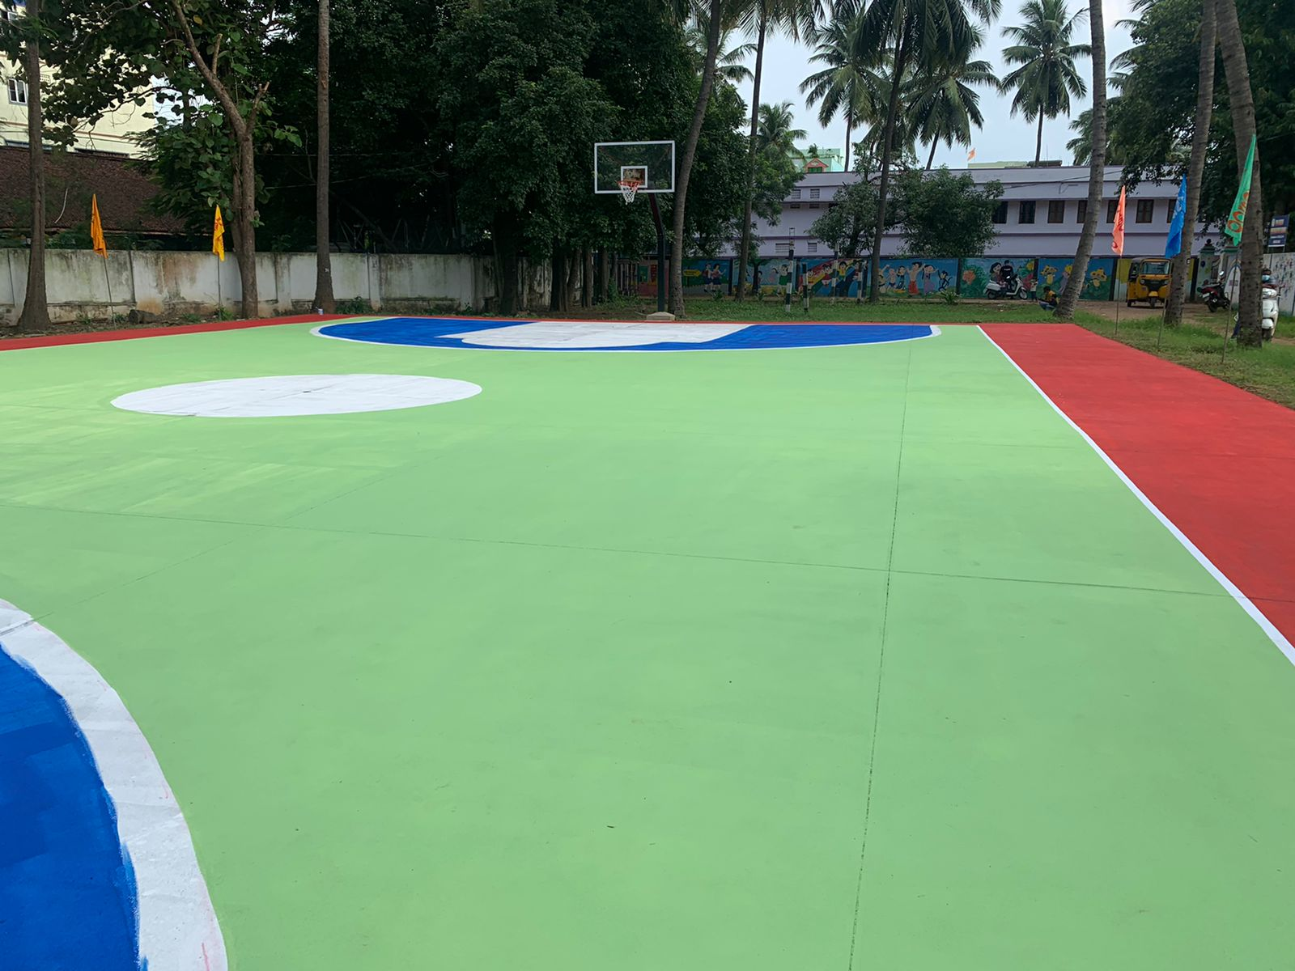
New Basketball Court – Don Bosco School, Ravulapalem
Don Bosco School, Ravulapalem was founded in 1981 to provide education for poor rural youth. Ravulapalem is a small town in Northern Andhra Pradesh home to a population of around 100,000 families, the school is the only institution in the area that provides education for poor students.
This year the school received financial assistance from a major donor to construct a new basketball court. The school has an enrollment of close to 800 students. The new basketball program will support sports programs being conducted at the school, and after school programs. Close to 1,200 families living in the area benefit from our institutional presence.
Don Bosco Technical Schools Network
The technical schools network was established by our organization to provide skill training opportunities to poor youth and school dropouts. Skill training programs ensures that youth gain dignified work and enter into professional career paths in the skills and services industry. Students who graduate from our technical schools complete their coursework within four months and gain employment in various businesses that provide carpentry services, plumbing, electricals, automotive repair, sales, logistics and hospitality. Our organization has a network of 35 businesses that recruit students from our technical schools network. This year thanks to the support of donors we were able to add new programs, renovate our campuses and support the accreditation of two of our institutions into formal industrial training institutes.
New Basketball Court
Don Bosco School, Ravulapalem, Andhra Pradesh
8

Slide 13
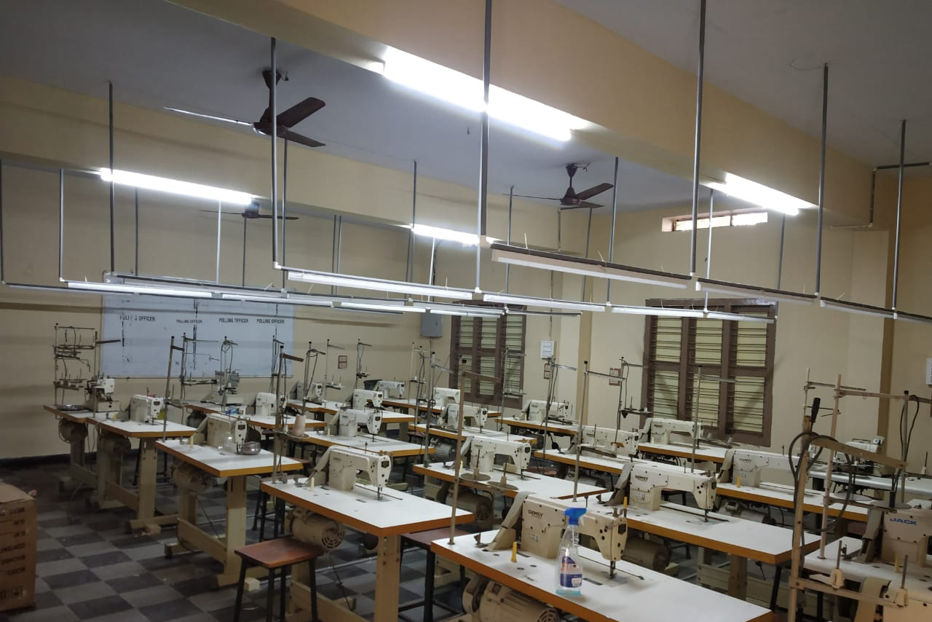
Renovation of Don Bosco Technical School, Kurnool & Ongole
This year our organization was able to secure funding from a major donor to fund the renovation of Don Bosco Technical School, Kurnool and Ongole. These two technical schools were established in 1992 and the year 2000 respectively. Since their inception these institutions have been training poor rural youth in various trades and services. Thanks to the help of our donor the two institutions are in the process of being renovated with new campus facilities and equipment.
Such renovations will support the accreditation process of converting these two institutions into formal industrial training institutes. This accreditation process will ensure that the two institutions will be able to provide various skill training programs that are recognized by the Government of India and are relevant to the latest workforce requirements for major industries and services operating in our region. Graduates from these institutions will earn higher salaries thanks to receiving degrees that are recognized by the government and industry.
New Skill Training Programs at DBHRDC, Gagillapuram
Since 2008, Don Bosco Human Resource Development Center, (DBHRDC) Gagillapuram, has been training poor youth in our region in a wide variety of trade skills such as sales, hospitality, tailoring, embroidery, electricals, plumbing, solar panel installation and diagnostics. The campus has integrated facilities to provide regular meals, sports facilities and residential accommodation for students enrolled at the center. Every year between 90 to 120 youth complete various courses over a 3 to 6 month program.
New Tailoring Workshop – Don Bosco Technical School, Ongole
9

Slide 14
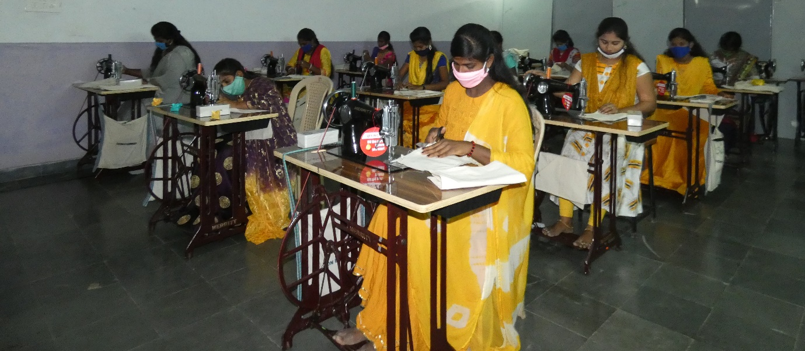
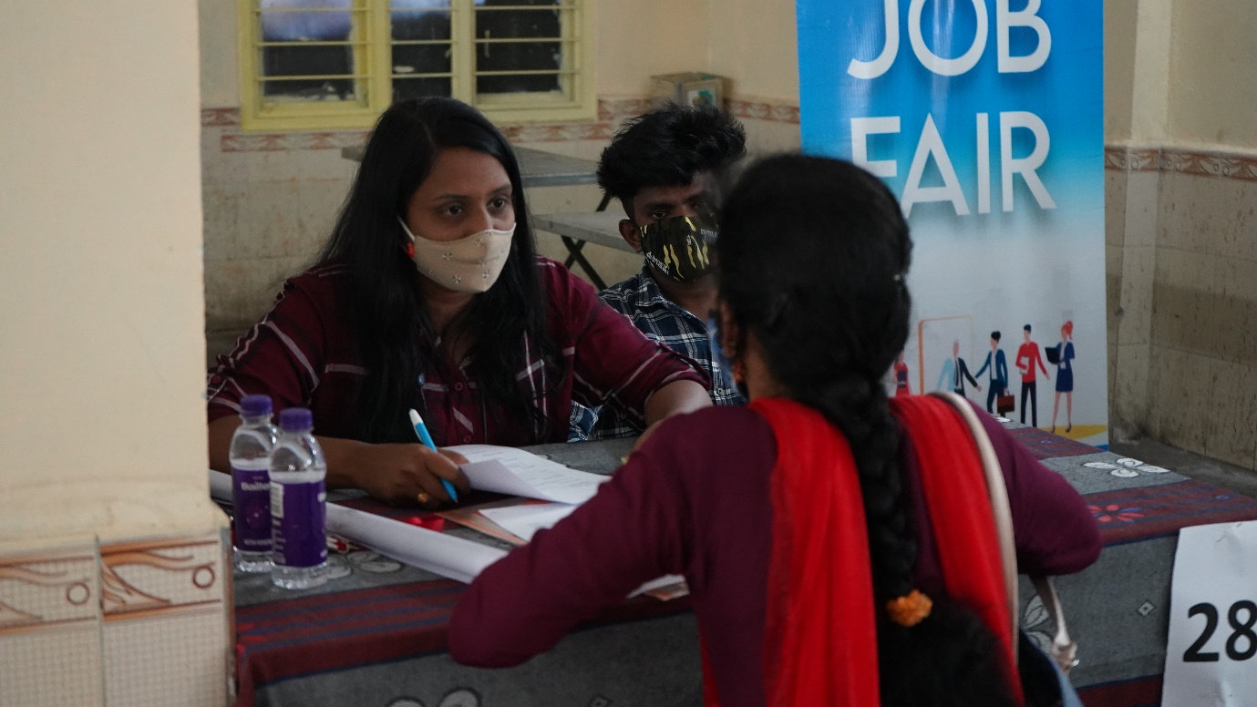
New Equipment at Don Bosco Human Resource Development Center, Gagillapuram, Telangana
What makes this campus special compared to our other institutions is that a good number of youth receiving training in our center have been rehabilitated through safe homes and homes for abandoned children operated by our organization and our partners. This year thanks to the support of various donors we were able to purchase new machinery to support our tailoring and embroidery program, as well as setup a new beautician program. Between 80 to 85% of graduates from this center are provided with immediate job offers from various small businesses and factories operating in the area.
Job Mela – Sanath Nagar, Hyderabad
Youth Services
Our organization was established primarily to serve youth and young people. Apart from education, skill training and rehabilitation of abandoned children. Our organization is focused on providing various youth services to help youth in our region. Outlined below are the youth services we offer and the programs we have implemented over the past financial year.
10

Slide 15
Job Placement and Career Services
Due to the demographics of our region and the demographics of the people we serve. A significant number of students enrolled in our schools, colleges and technical schools come from households where their parents have not received a formal education. Such youth require assistance to choosing an appropriate career path for themselves based upon their personality and strengthens.
Since 2004 we have been providing career services to youth who belong to our institutional network and poor youth seeking assistance to find employment in Hyderabad. Every year close to 3,500 youth benefit from the careers office operated by our organization. This year we were able to further develop our careers office by launching an App and new Website – DonBoscoJobs.org to provide various youth services to youth in our region. Outlined are the youth services we provide to youth:
Career Guidance and Resume Writing
Job Placement Program with our Network of Employers
Preparation for Job Interviews and Essential Work Place Skills
Career Workshops in Private and Government Schools and Colleges
Program Impact
Every month between 80 to 110 youth seek services from our Careers Offices, we have a network of 35 businesses that recruit youth seeking job assistance from our office, and every quarter we organize Job Melas in Hyderabad where youth can meet with prospective employers at our main office at Sanath Nagar. We also organize between 35 to 60 career workshops in various high schools, colleges and technical schools in our region. Outlined below is the impact of the program:
Item | Timeline: April, 2021 to March, 2022
No. of Registered Job Seekers | 989
Item | Male | Female | Total
Employment History
New Job Seeker | 265 | 182 | 447
Employed | 307 | 199 | 506
Work Experience
Fresher | 535 | 298 | 833
Less than 1 Year | 25 | 19 | 44
Less than 2 Years | 24 | 13 | 37
Above 2 Years | 47 | 28 | 75
Age Demographics
Up to 18 | - | - | -
18-24 | 369 | 251 | 620
25-34 | 229 | 81 | 317
35-44 | 21 | 16 | 37
Above 45 | 12 | 3 | 15
Total | 631 | 351 | 989
11

Slide 16
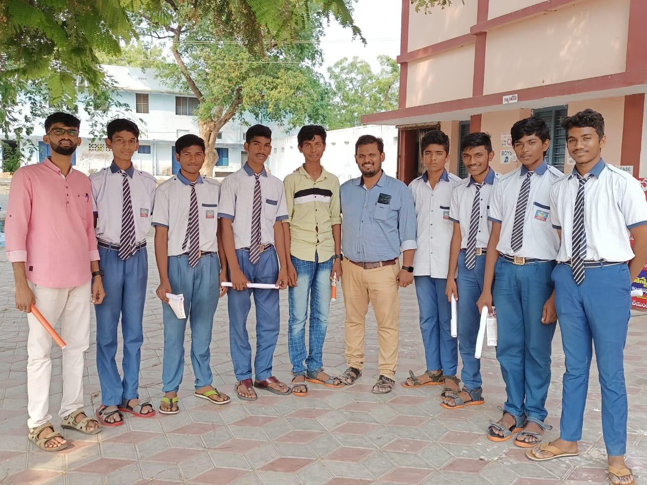
Protection of Minors Program – Guntur, Andhra Pradesh
Protection of Minors Program
Over the past 3 years our organization has been conducting workshops in all Don Bosco Institutions on Protection of Minors and Safe Environment Training. The goal of this program is to certify our institutions as safe zones where children, youth, young people and employed personnel can work in a safe and secure environment. The program focuses on creating an environment where child neglect does not occur on our campuses.
Teachers, staff members and students are trained in reporting various forms of abuse and neglect to administrators and directors of our institutions. These personnel are trained through the program to address these issues effectively. This program also teaches students and those employed in Don Bosco and our partner Institutions about the importance of treating everyone equally, respecting differences and holding people accountable for their actions. We have 32 institutions in our region that support over 60,000 families. All of these institutions participate in this program.
Gender Equality Program
In keeping with our commitment towards advancing various forms of equality and protecting the dignity of the human person. This year with the support of donors we launched the Gender Equality Program. The program undertakes workshops primarily in government schools where we address the literacy gap between men and women, promote gender equality and address various evils that undermine human flourishing. In recent months close to over 600 youth have attended our seminars in over 20 government schools and colleges. We hope that around 3,500 youth will attend this program in the coming year.
12

Slide 17
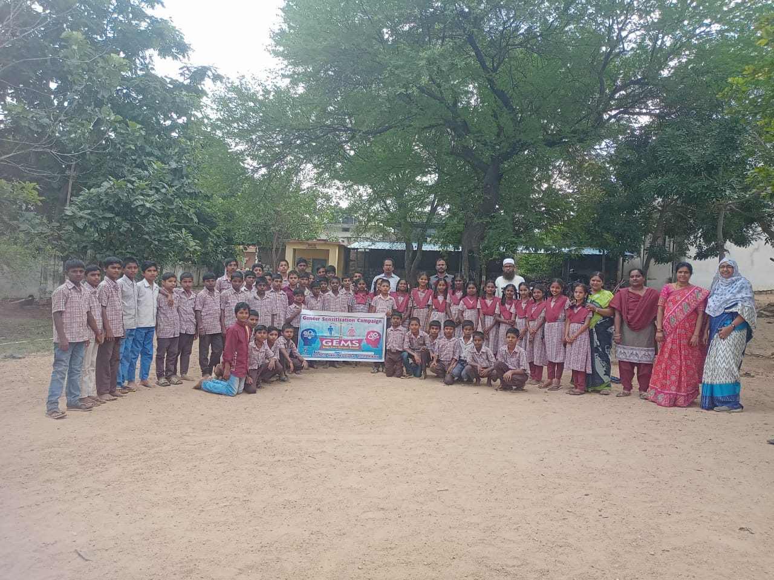
Gender Equality Program at a rural Government School
Northern Andhra Pradesh
Community Outreach
Environmental Programs
In recent years, climate change, the destruction of the natural world, food and water insecurity have undermined public health, safety and economic prosperity of poor communities that depend on the climate for their sustenance. In 2022, India experienced the hottest heat wave ever recorded. High temperatures made living unbearable for those who lack access to air conditioning and have to work in the sun. In order to address the environmental crisis our organization has committed to powering our network of charitable institutions with solar energy.
This year we completed a one-year program of installing solar panels on all our Don Bosco Institutions thanks to the support of a major donor grant. This program will help reduce our operational expenses, carbon footprint and improve workplace efficiency since we will have regular power supply during power cuts. By the end of this financial year, we intend to have 825 kWs of installed solar panels spread across all 32 Don Bosco institutions in our region. The solar panels will mitigate over 1093.29 tons in carbon emissions every year and reduce our power consumption from 25 to 75% during peak times of the day.
13

Slide 18
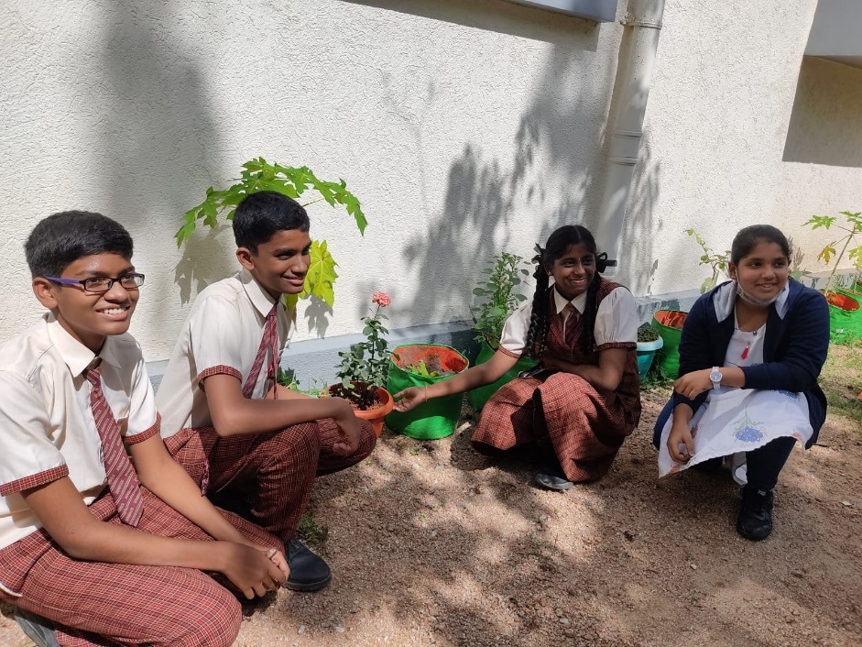
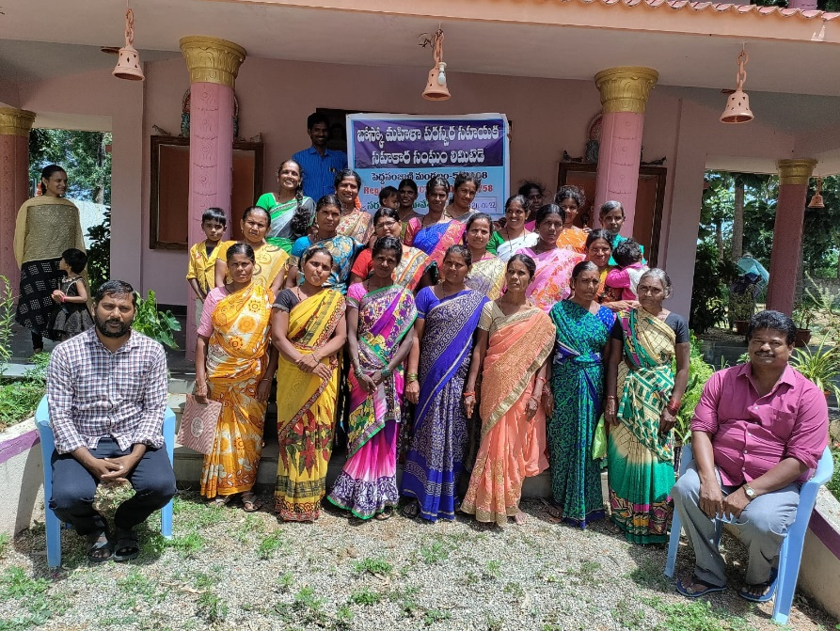
Don Bosco Green Alliance, Don Bosco School
Bandlaguda Jagir, Hyderabad
Apart from installing solar panels across our institutions, we are committed to driving environmental awareness in our academic institutions. In the coming year, we intend to increase the green cover on our campus, implement effective waste management programs in our institutions, and expand our capacity to train youth in the clean energy industry.
Microcredit Program – Don Bosco School
Punganur, Andhra Pradesh
Microcredit Program
In the early 2000s, our organization established the Microcredit Program as a community mechanism to create employment opportunities and reduce extreme poverty in rural and urban slum areas of our region. (continued)
14

Slide 19
Due to the scale of poverty, creating and advancing economic opportunities for poor communities reduces the burden on charitable organization to support poor families. The microcredit program caters to poor women and mothers living below the poverty line only, these women enroll in the program and gain access to low interest rate loans that are below market rates. These women must build and grow their businesses, repay the loans and create employment opportunities for other women and youth residing in their communities.
The repayment of loans creates a self-sustaining financial cycle, where other women have access to the same capital to build and grow their businesses. The repayment of loans, forces these women to become financially independent and accountable in the way they operate their respective organizations. Close to 10,000 women benefit from the Microcredit Program. The table below are the number of women who have received financial assistance from the program. Our organization is looking for partners to support and advance this initiative.
Community Partnerships – CSO Program
Our organization with the support of BoscoNet, Delhi has established a network of 124 CSOs (Civil Society Organizations) operating primarily in Andhra Pradesh and Telangana. These organizations are grassroot charities that are engaged in poverty alleviation, environmental stewardship and addressing various forms of inequality. Over the past two years, we have been training these organization in advocacy, community organizing and outlining various opportunities to access government programs that help the poor.
Thanks to our collaboration and networking, these organizations have helped support our efforts in undertaking COVID-19 and flood relief activities this year. We have been able to target remote rural communities and certain urban slum areas where communities, children and families have not received any form of assistance from independent charities. This network or platform CSOs provides donors and other like minded entities an opportunity to collectively work together to bring about a transformation in the culture.
15

Slide 20
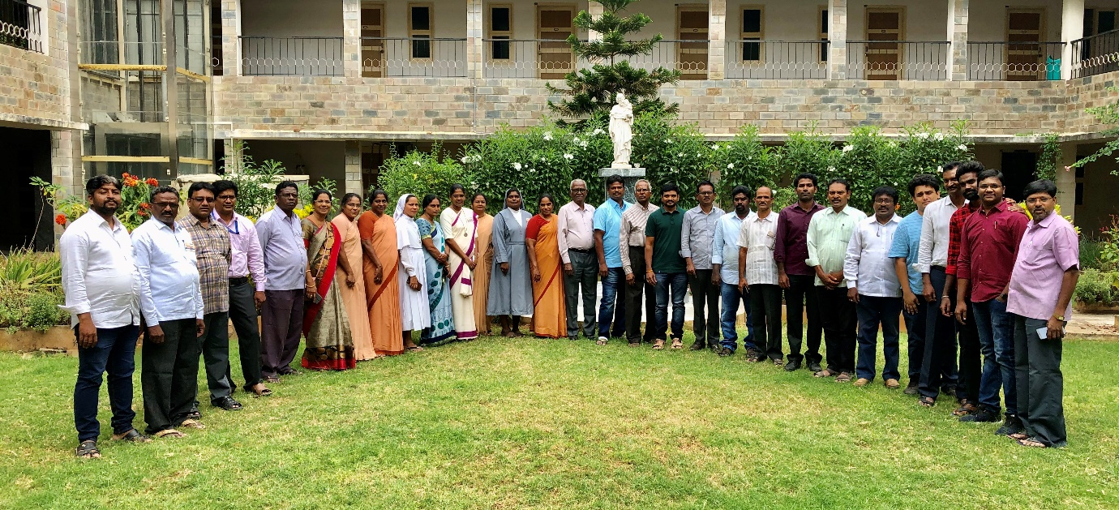
Meeting with various CSOs
Don Bosco Provincial House, Hyderabad, Telangana
Our Donors
Our efforts over the past financial year would not be possible thanks to the efforts of our donors. Outlined below are donors who have sponsored and supported our mission.
Independent Donors – Foreign
Cecil Beck, Switzerland
S. Zgaoui, Netherlands
Klaus Eichelmann, Germany
Charitable Foundations and Private Enterprises
16

Slide 21
Going Forward
In keeping with our mission as the Salesians of Don Bosco and our institutional mandate of supporting Don Bosco Institutions in our region outlined below are the priorities for us an organization for the coming financial year. Our organization is looking for donors and charitable partners to fund such initiatives.
Our organization depends on the good will of donors to support our outreach programs and charitable efforts. We have maintained good relationships with our donors since our inception. We sincerely hope that donors will see the value of the work we do and support us in our efforts.
Scholarship Programs
Providing more poor students and existing students with access to scholarship programs to keep them enrolled in schools, colleges and technical schools.
Campus Facilities and Student Services
Improving the quality of campus facilities and student services to students and poor children who benefit from our institutional network.
Skill Training
Providing relevant skill training opportunities and networking with major employers to provide high paying and rewarding professional careers to poor youth seeking skill training and employment through our institutional network.
Microcredit Program
The Microcredit Program is in need of financial assistance and strategic partnerships to scale up the business units created by the program. There is a need to provide more women in our region with access to the program in communities where we are not present in and to expand the program to South Odisha which is the poorest state in India.
Environmental Programs
Implementing sustainable environmental initiatives to reduce waste to landfill, improving tree cover in our Don Bosco Institutions, removing garbage and waste disposed in public areas and creating circular economy initiatives to alleviate extreme poverty in our region are activities our organization is actively considering.
17

Slide 22
Contact Information
Bosco Seva Kendra
Don Bosco Provincial House
Don Bosco Nagar Post, Bandlaguda Jagir
Hyderabad, 500086, Telangana, India
Website: www.boscosevakendra.org
Mobile: +91 (944)-005-3219
1

