Slide 1
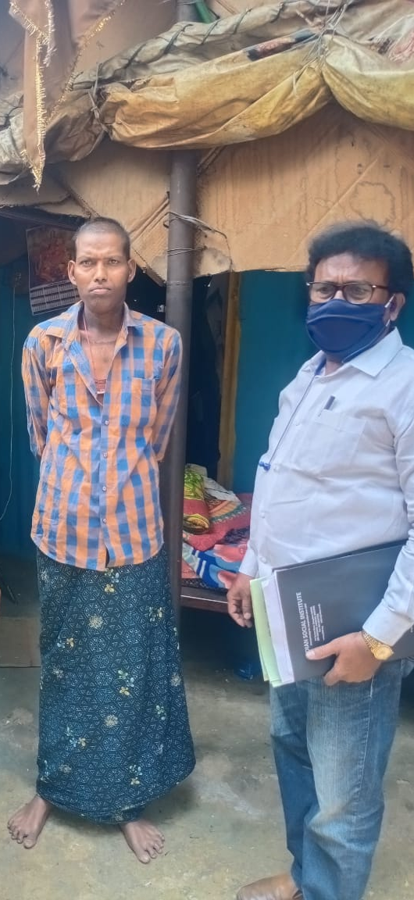
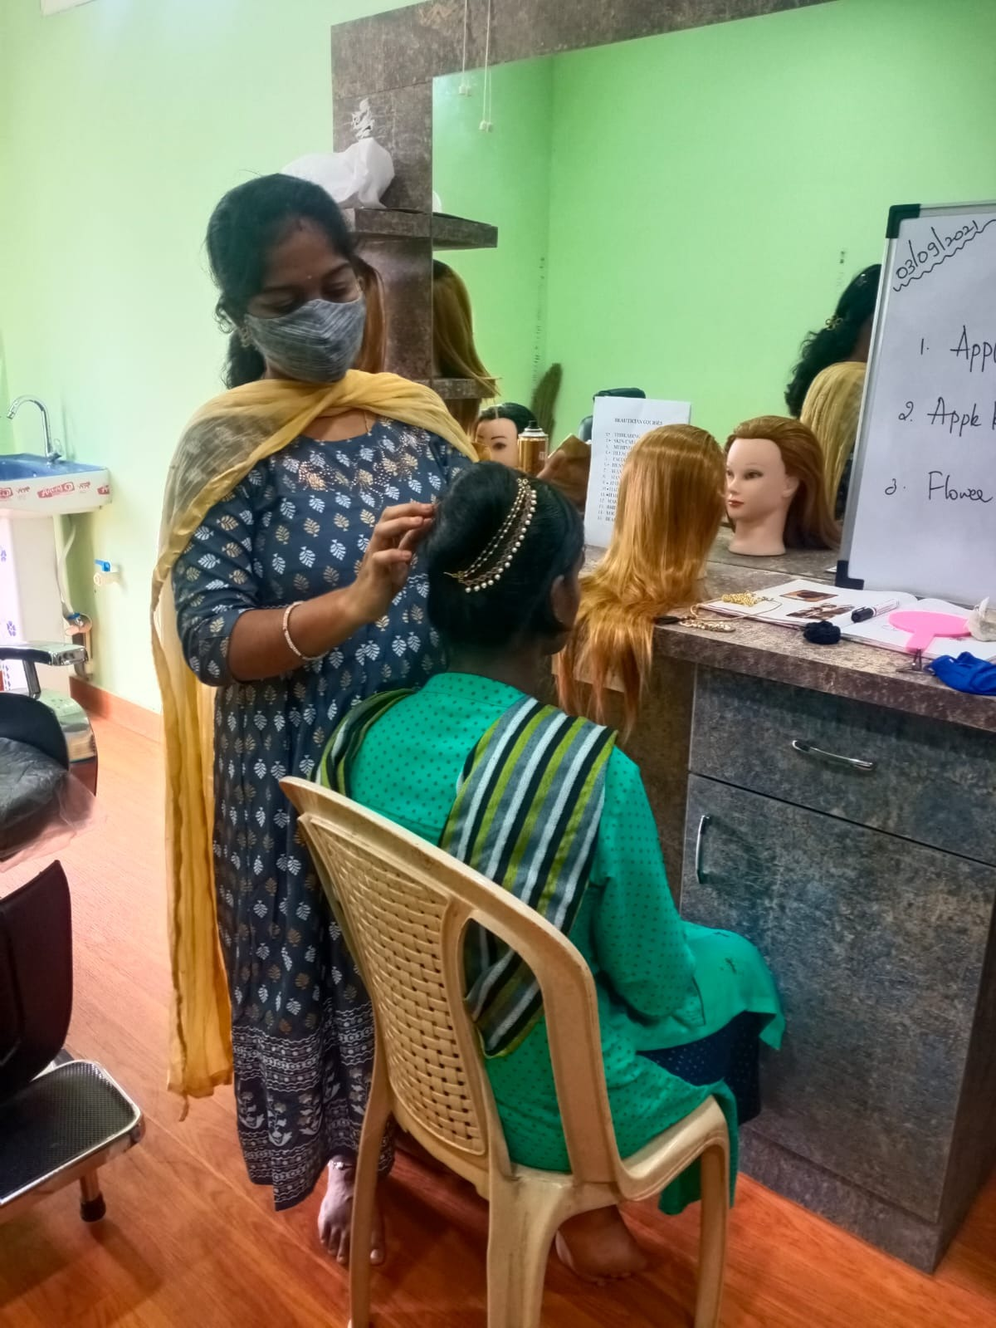
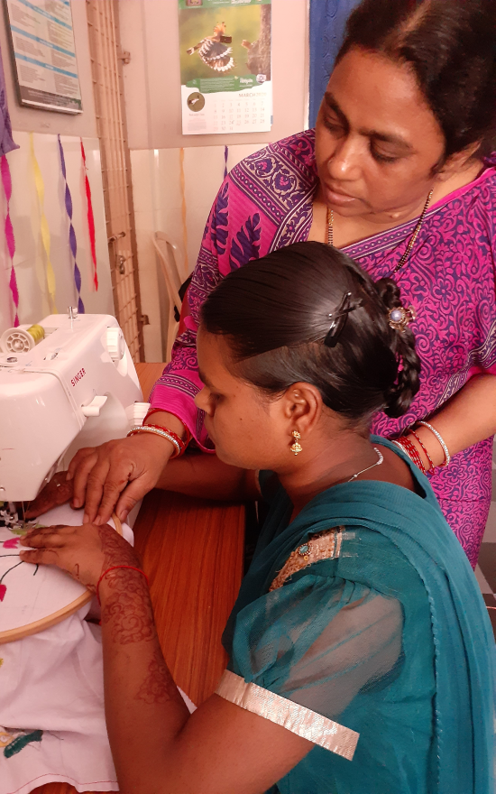
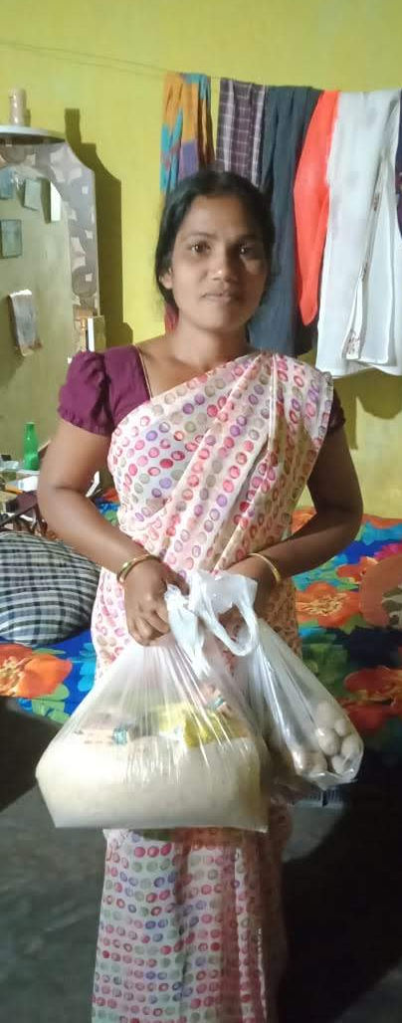
Year of COVID-19 Annual Report 2019/2020 Bosco Seva Kendra, Hyderabad, India

Slide 2
About us
Bosco Seva Kendra (BSK) was established in 1993 as an independent charitable agency under the leadership of the Salesian Province of St. Joseph, Hyderabad to help those who live in poverty in our region. As a charitable organization Bosco Seva Kendra is dedicated to providing essential community services to the poorest of the poor by engaging with donors and various charitable organizations interested in making a positive difference. We operate across 3 states in South East India – Andhra Pradesh, Telangana and south Odisha, and support a network of 32 Don Bosco Institutions located in this region. This annual report intends to communicate the various activities we have undertaken in this financial year 2020-2021 independently as an organization and with our network of Don Bosco Institutions.
Legal Disclosure
All information disclosed in this document cannot be reproduced or copied. The Annual Report is intended to communicate the mission of our organization. For any inquiries, feel free to reach out to us in the contact information mentioned below. Bosco Seva Kendra is a non-profit agency established and operated by the Salesian Province of St. Joseph, Hyderabad. We provide charitable services to all members of society regardless of ethnicity, age, gender, economic status or religious affiliation.
Contact Information
Bosco Seva Kendra
Don Bosco Provincial House
Don Bosco Nagar Post
Bandlaguda Jagir
Hyderabad, 500030
Telangana, India
www.boscosevakendra.org
+91 (944)-005-3219
Print Information
Copyright © Bosco Seva Kendra, 2021

Slide 3
Message from the Executive Director
Dear Friends of BSK
We began this year with an unprecedented event in human history, the start of a new pandemic. Our organization was able to coordinate various relief efforts despite the lockdowns, remote working, and the fear of being infected with this virus. Thanks to the help and support of our donors, we have been in a position to undertake significant outreach over the past several months by supporting tens of thousands of poor families living in slum areas and poor communities across our region who have been deeply affected by the pandemic. In this message, I would like to sincerely thank our network of donors who have been able to support such efforts in times of great uncertainty.
Apart from undertaking COVID-19 relief activities, our organization has also been in a fortunate position this year to have received a generous grant from a major donor to support the installation of solar panels across a network of 31 Don Bosco Institutions. This grant will help us reduce our collective carbon emissions, operate our institutions during power cuts, and improve our environmental credentials. Apart from this initiative our organization will continue its efforts in providing relief and assistance to those affected by the ongoing pandemic. We will continue in our mission of supporting the various charitable efforts of Don Bosco Institutions located in our region. We ask that readers pray for an end to this end, and work with us to help those in need.
Sincerely,
Fr. Sudhakar Bellamkonda SDB
Executive Director
Bosco Seva Kendra, Hyderabad, India

Slide 4
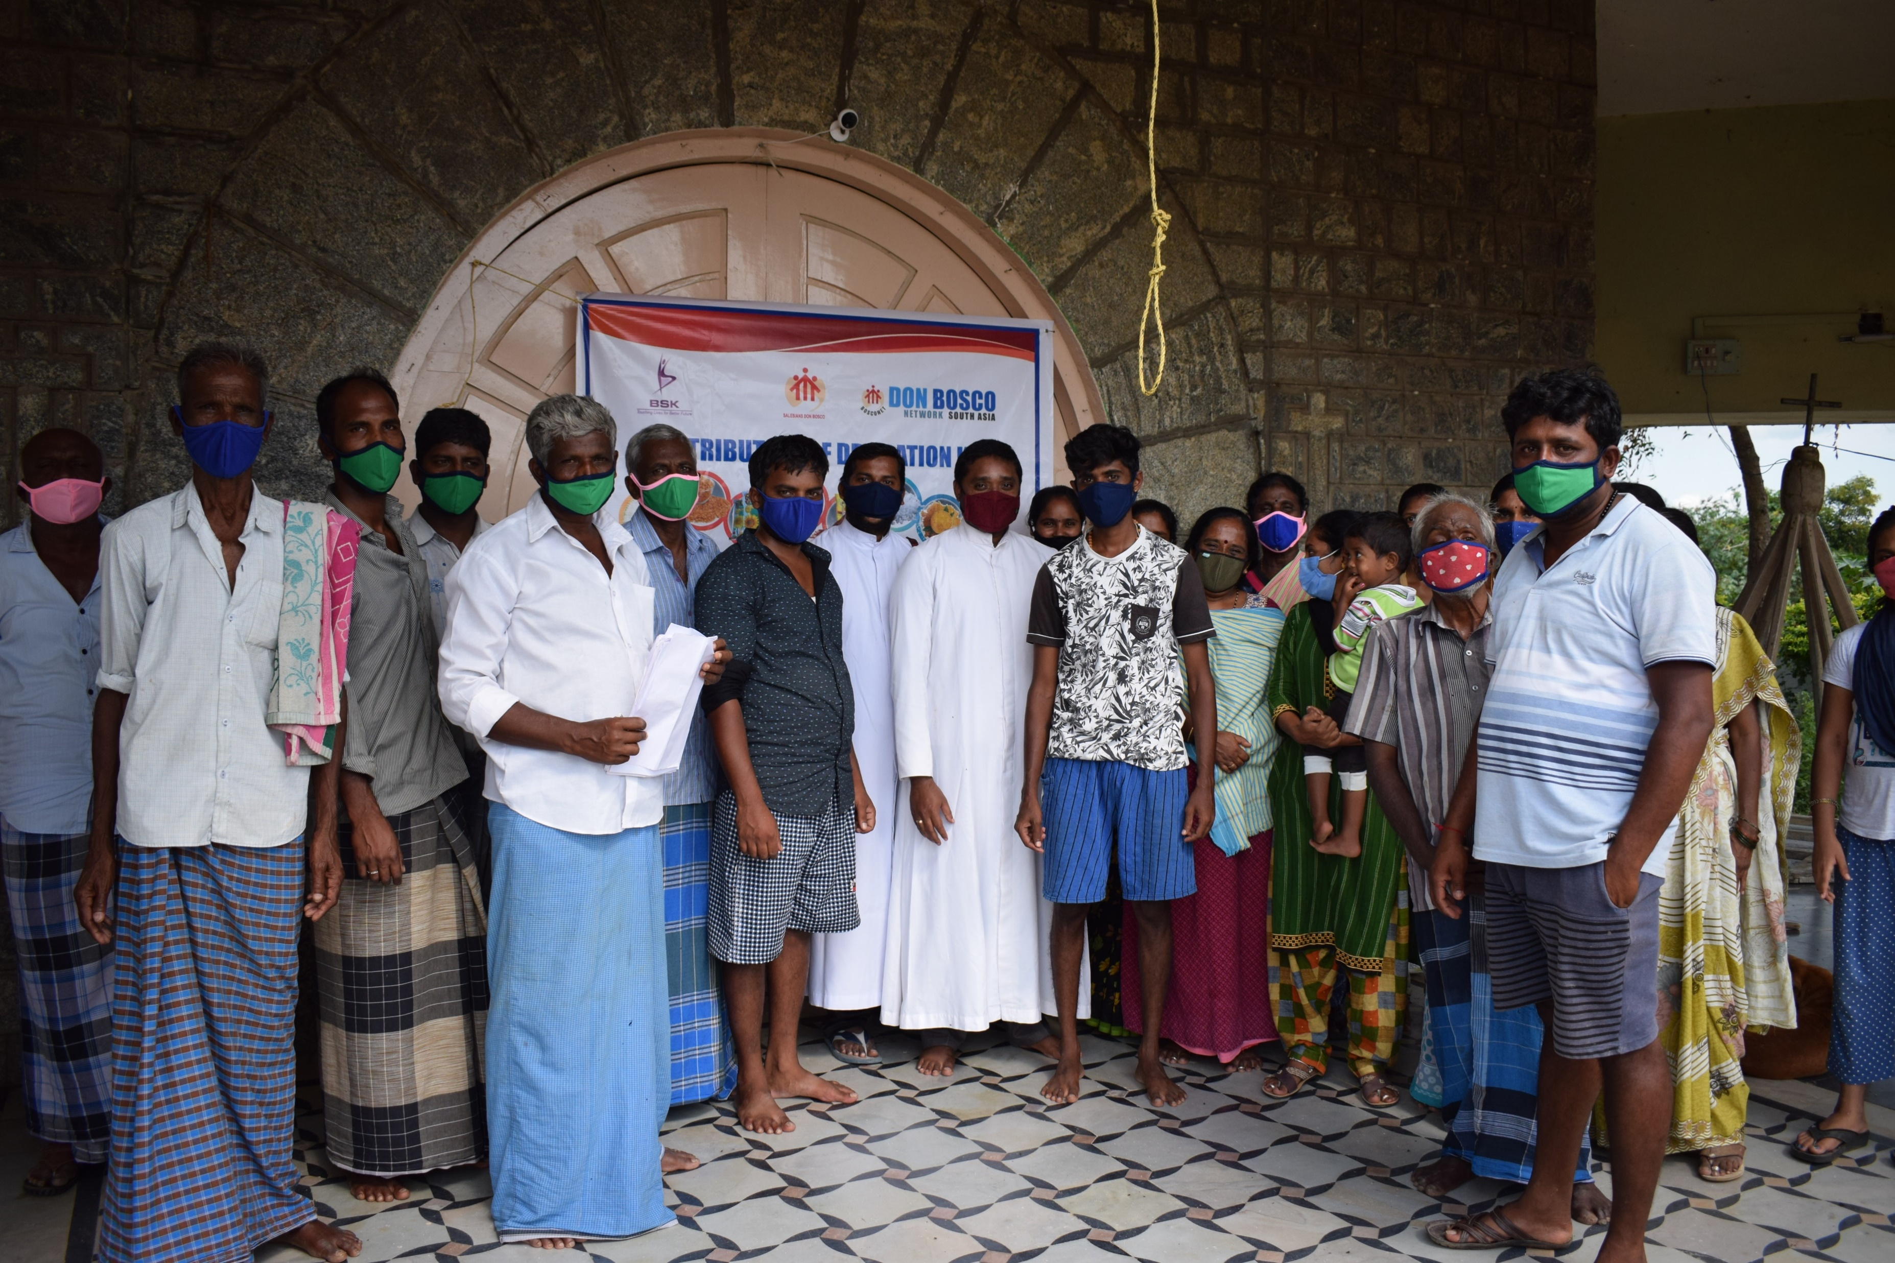
Table of Contents
Year of COVID-19 1
Our Impact 2
Institutional Programs 4
Outreach Activities 6
Summary and Conclusion 17

Slide 5
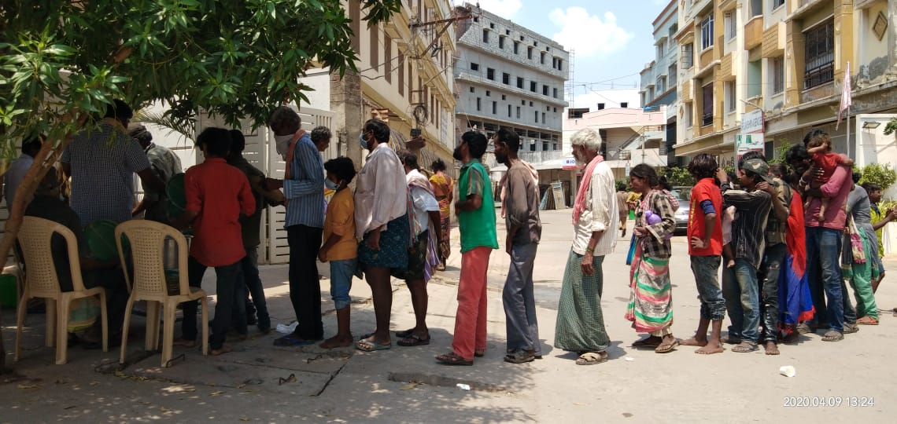
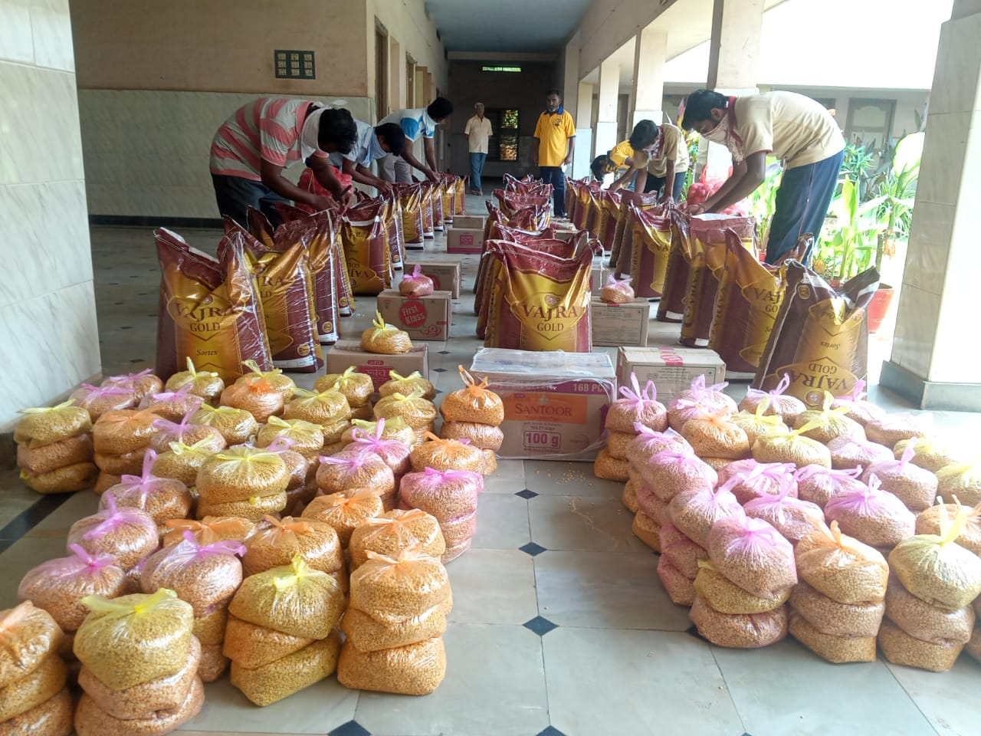
Year of COVID-19
COVID-19 Outreach
Over the past year our organization has been primarily focused on providing relief to those affected by the economic fallout of the pandemic. COVID-19 unlike other social issues spares no one, moreover the social and economic consequences of the pandemic are as severe as being infected with the virus. In India, over 90% of all economic activity in India is undertaken in the informal economy.
Independent businesses, daily labourers and families who dependent on the retail and services economy are heavily impacted due to lockdowns. Furthermore, the suspension of travel resulted in hundreds of thousands of migrant workers being stranded on construction sites, urban slum areas and poor communities with nowhere to go and no source of income to support themselves and their families.
Outlined below are the 3 strategic steps we took as an organization:
Institutional engagement with various entities concerning the impact and the consequences of the pandemic.
Institutional engagement with Don Bosco Institutions in India and partner organizations concerning the impact of this virus on institutional operations, donor relations and financial stability of the institutional network.
Prioritizing outreach and support for migrant labourers, poor families, children and youth who are at high risk of being economically affected by the pandemic, and those at risk of high exposure to the virus (healthcare workers and essential civil services).
At the start of the pandemic our organization was uncertain whether donors would aid us considering the worldwide reach and devastation of this virus. To much to our surprise, donors responded and we were able to start our outreach by posting flyers in public areas. This was followed by securing permission from municipal corporation, police and civil servants to undertake outreach to support those who had lost their income due to the pandemic. On the top left corner is the distribution of hot meals to homeless persons, migrant labourers and families living in slum areas in Kurnool, Andhra Pradesh. On the bottom left corner is the packaging of non-perishable food items for distribution to poor families living in urban slum areas in Ongole.
The vast majority of our outreach programs were undertaken by staff members associated with our organization and volunteers. All safety measures and precautions were followed, gladly no one got infected during the distribution program.
1

Slide 6
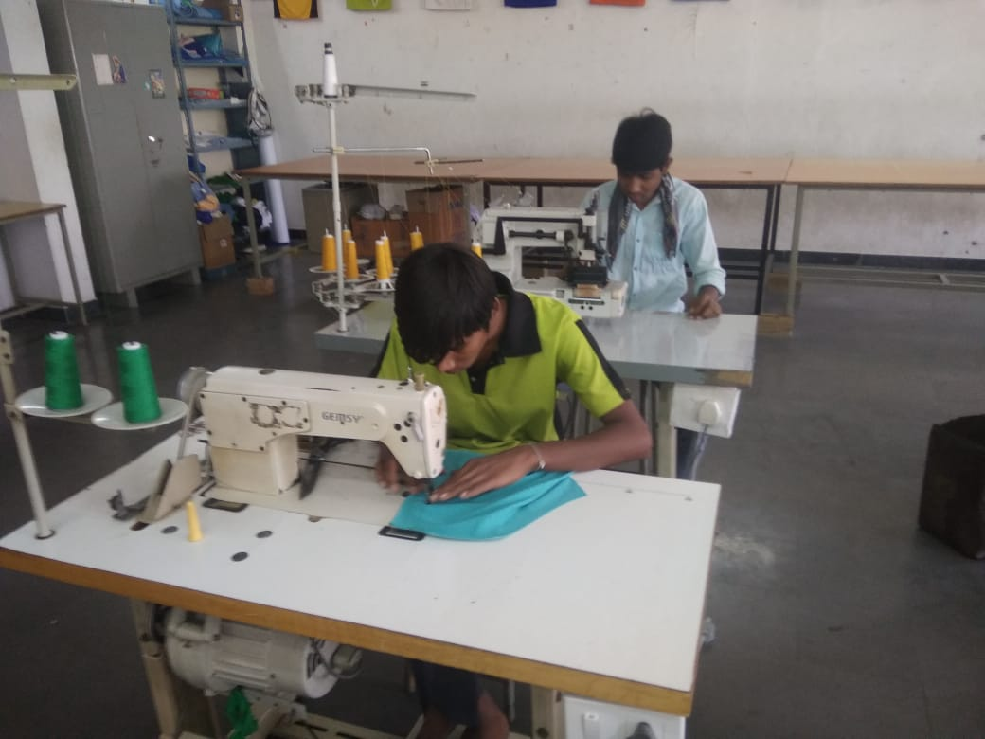
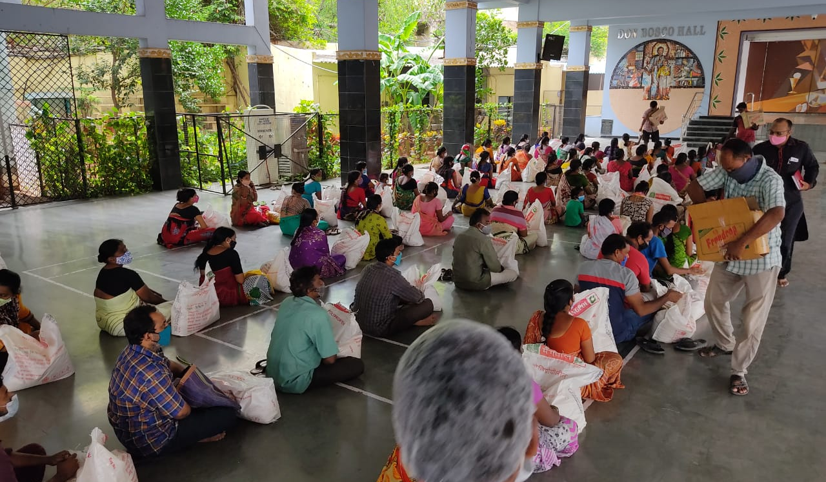
Our Impact (I/II)
First Wave of COVID-19: First 180 Days of the Pandemic
Outlined below is our impact during the first 180 days of the pandemic: March 26, 2020 to September 26, 2020.
Second Wave of COVID-19
The table below is the second wave of the pandemic: January to March, 2021.
Stitching of Face Masks in our Skill Training Centers
Distribution of Food Packages to Poor Families
2

Slide 7
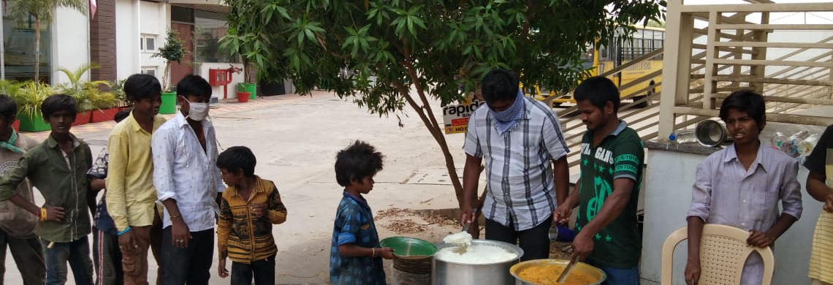
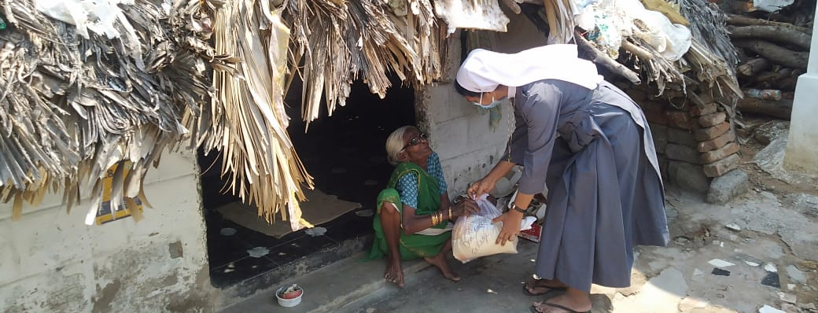
Our Impact (II/II)
Our Recognition
Over the past financial year over 500,000 people have directly benefitted from our outreach. Such efforts make us one of the largest independent relief entities in this region of India. Civil authorities, beneficiaries and those who were involved in the program including donors were appreciative of scale and speed of the outreach we have accomplished over this period of time. Pictured below are some of the beneficiaries of this program.
Outlined below are those who benefited from our outreach:
Homeless persons and elderly
Families living in slum areas
Street children and youth
Migrant labourers stranded on construction sites
Unemployed persons
Municipal workers – Street cleaners
Unemployed youth and young people
Employees and staff members of Don Bosco Institutions
Our Outreach Experience
Our organization has undertaken outreach programs across this region to help those affected by the pandemic. We have seen the scale of this crisis, the scale of extreme poverty in our region, and can see how fragile life really is. Violations against natural law undermine human flourishing and human dignity. The loss of human life in our region undermines the safety, security and welfare of families, especially those who depend on their caregivers to support their households. Such challenges will undermine the welfare and safety of the family in the years and decades to come. On the top left corner is a hot meal distribution program, followed by a distribution of food grains to the elderly living in slum areas and migrant labourers in rural areas.
3

Slide 8
Institutional Activities
Despite the challenges of an ongoing pandemic, our organization has been able to conduct itself and focus on our core institutional activities. Outlined below are the main institutional activities we have accomplished during the past financial year.
Scholarships for Poor Students – Don Bosco Schools and Colleges
Bosco Seva Kendra works closely with independent donors to provide scholarship opportunities for poor children and youth in enrolled in schools. The program ensures that poor families are better equipped to support the education of their children. Our organization was fortunate to have received financial assistance from donors to increase the number of children receiving financial aid for this financial year. The table below are the number of children who have received new scholarships for this year.
New Basketball Court – Don Bosco School, Wyra
Prior to the pandemic we were grateful to have received financial assistance from a major donor to construct a new basketball court at Don Bosco School, Wyra. This school educates poor children whose parents are either farm labourers or daily wage workers. Close to 90% of students enrolled in the school receive some form of financial concession from the school. The school was established in 1993 and began life teaching poor children in a tin shed. Today, the school has evolved into an integrated campus with bus services, new computer labs and libraries. Pictured on the following page is the construction program and inauguration of the new basketball court. Our organization is deeply grateful to our donors for their support and was able to complete the project despite the onset of the pandemic.
Don Bosco Navajeevan, Warangal
In recent years our organization has been able to operate a day care center for street children in Warangal. The day care center is located near the main railway station in the city, and is in walking distance to various slum areas where our beneficiaries reside in. This year, our organization was able to provide regular meals, primary healthcare, academic assistance, clothes and conduct after school programs to over 50 slum children who are associated with this center. We have provided photographs of the beneficiaries in the following page.
Location | No. of Students on Scholarship
Hyderabad | 17
Mangalagiri | 99
Muniguda, Odisha | 24
Nalgonda | 35
Ongole | 14
Pezzonipet | 66
Ponnur | 23
PT Parru | 38
Ravulapalem | 23
Wyra | 41
4

Slide 9
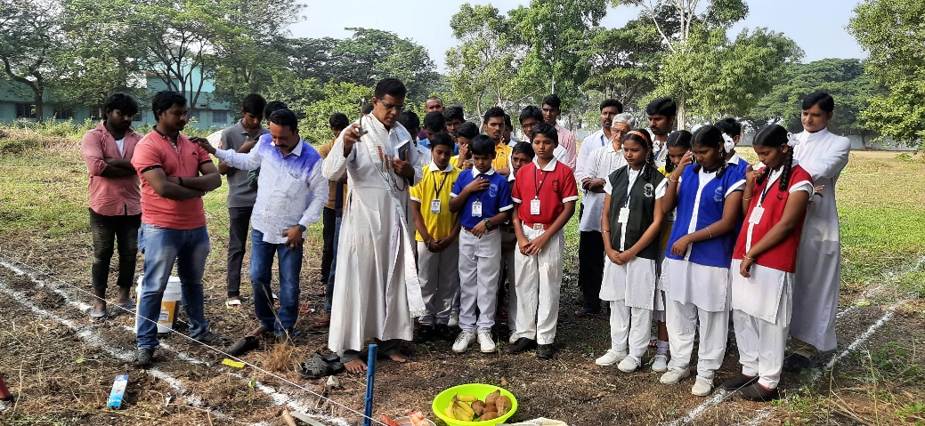
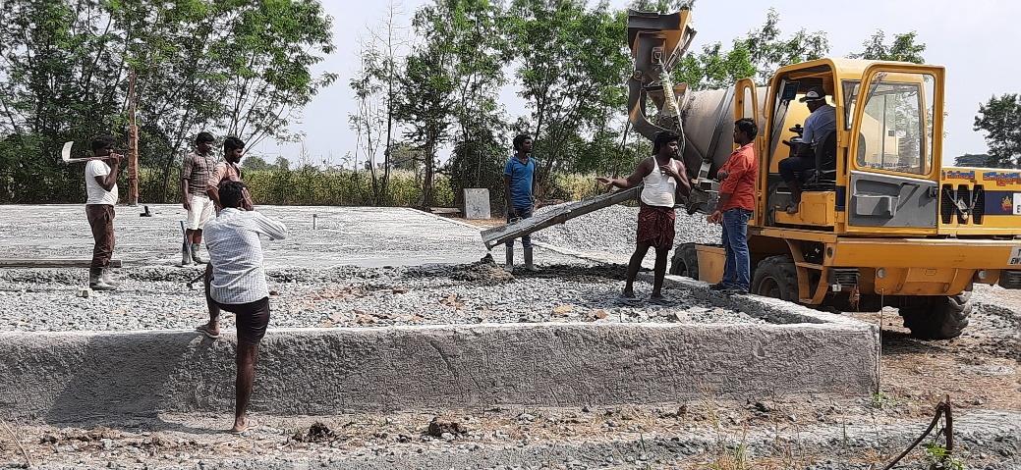
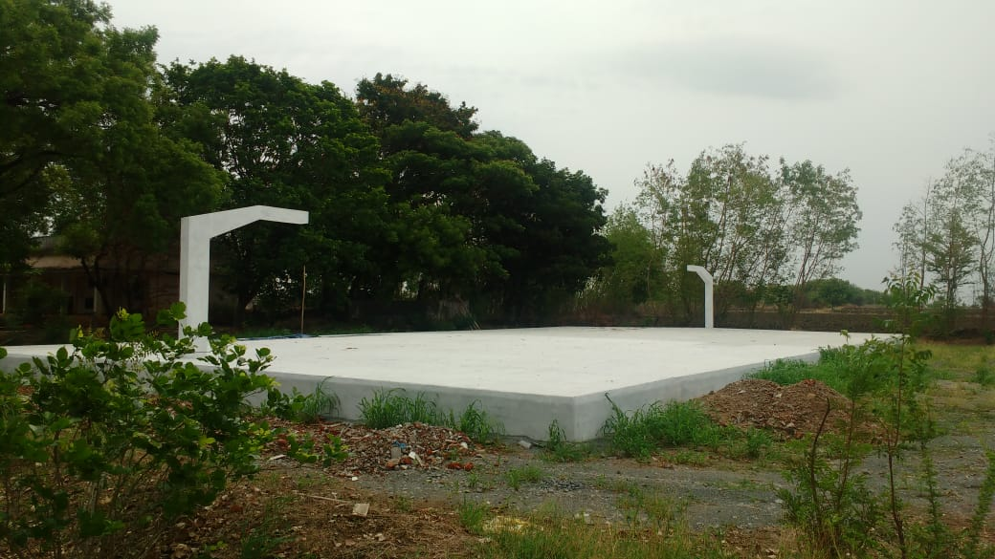
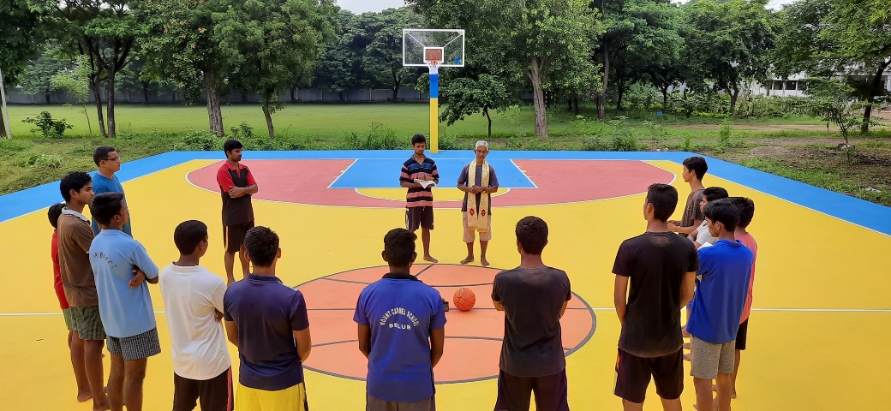
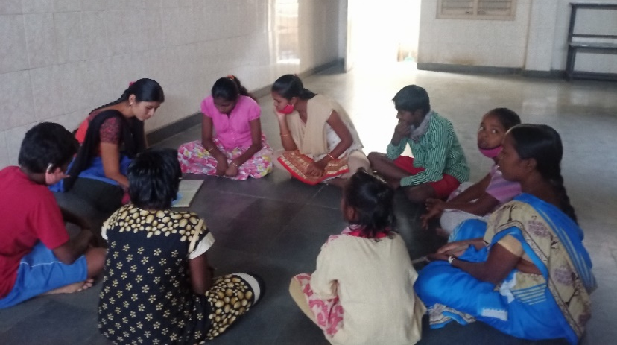
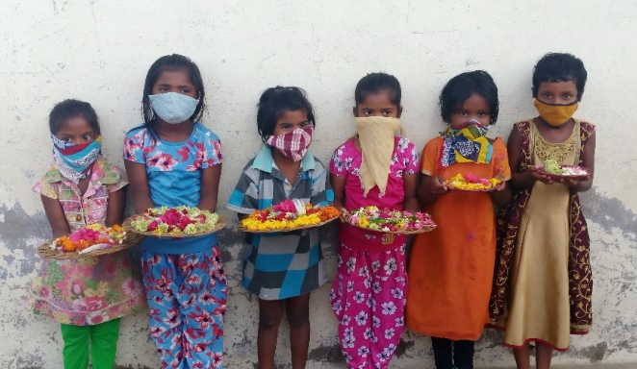
Institutional Activities
The first 4 photos concern the construction and the inauguration of the new basketball court at Wyra, followed by photographs of our beneficiaries at Don Bosco Navajeevan, Warangal. Apart from the these two programs are organization was involved in other institutional activities mentioned below.
Protection of Minors and the Safe Environment Training Program
The Protection of Minors and the Safe Environment Training Program began in 2019 to serve an outreach program to instruct students, teachers and staff members on social issues that undermine the dignity and sanctity of human life. The program was established to create mechanisms in schools and colleges where students and staff who are suffering from various violations against human dignity would be able to receive counselling, care and assistance from the leadership of these respective institutions. Over the past year we have been able to conduct 1 hour workshops across 6 institutions, close to 294 students have benefitted from this program. Due to the ongoing pandemic we have had to suspend our program, but we hope to resume such activities when things return to normal.
5

Slide 10
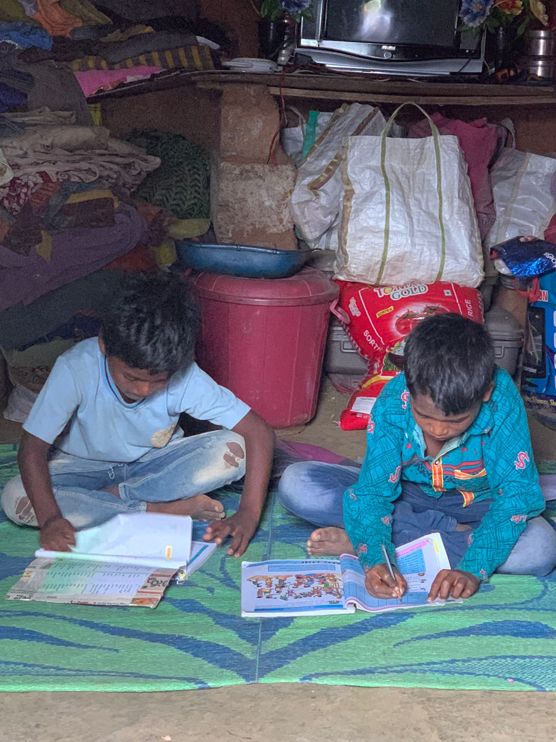
Migrant Desk Program
Migrant Desk
In recent years, high migration into major cities has undermined decades of efforts to reduce extreme poverty in urban areas. Heavy migration has added pressure on public services and charitable agencies are not equipped to meet the needs of hundreds of migrants seeking help and assistance from these institutions. Don Bosco Youth at Risk Network, India has launched a Migrant Ministry program aimed at develop mechanisms within Don Bosco Institutions to support the welfare of migrants. Outlined below are the main objectives of this program that commenced this financial year:
Providing Government Identification Cards
Career Services and Job Placement
Enrolment in State Welfare Programs
Enrolment in State Insurance Protection Programs and Labour Unions
Enrolment into Skill Training Programs
These services aim to prevent labor exploitation, reduce extreme poverty and provide various social services to such families. During the first lockdown, millions of migrant laborers were left stranded on construction sites and urban slum areas. These families had no money to feed themselves or support their children. In recent weeks, our organization has surveyed 8 communities, engaged with 3 government offices, spoke with 6 major contractors in Hyderabad that recruit migrant labor, and befriended 250 migrant families living in slum areas.
Needs of Migrant Families
During our survey of migrant families in Hyderabad. Families informed us about the services they need to support themselves and their children.
Organizing Tuition Centers in Slum Areas
Conducting workshops on Labour Laws
Access to Primary Healthcare and Sanitation on Construction Sites
Dignified Work and Fair Wages
In the coming months and years, our organization aims to develop and support such programs with the support of our partners. On the left are the living conditions of most migrant families living in Hyderabad and in other parts of our region.
6

Slide 11
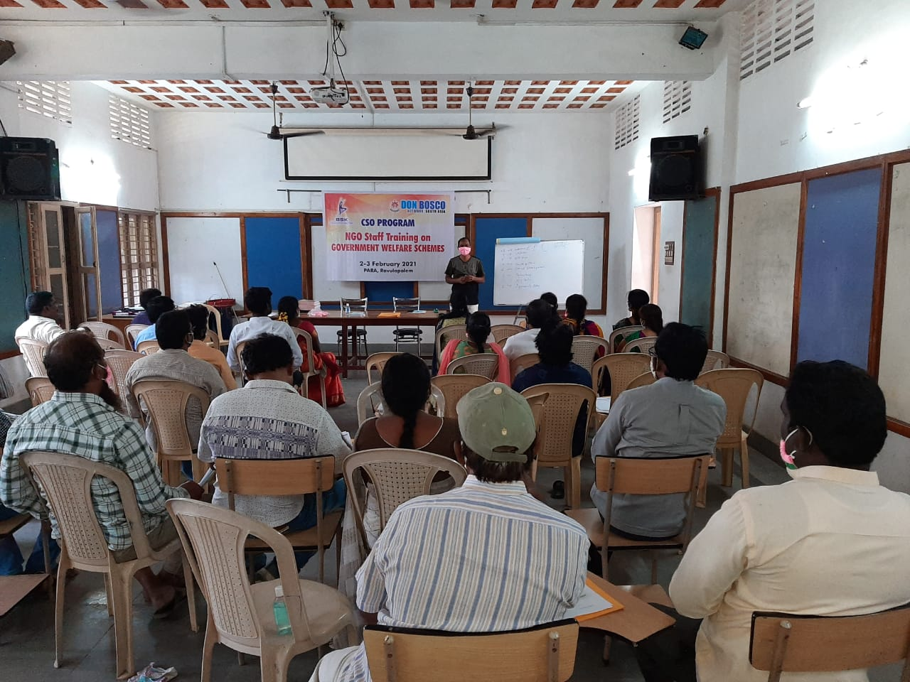
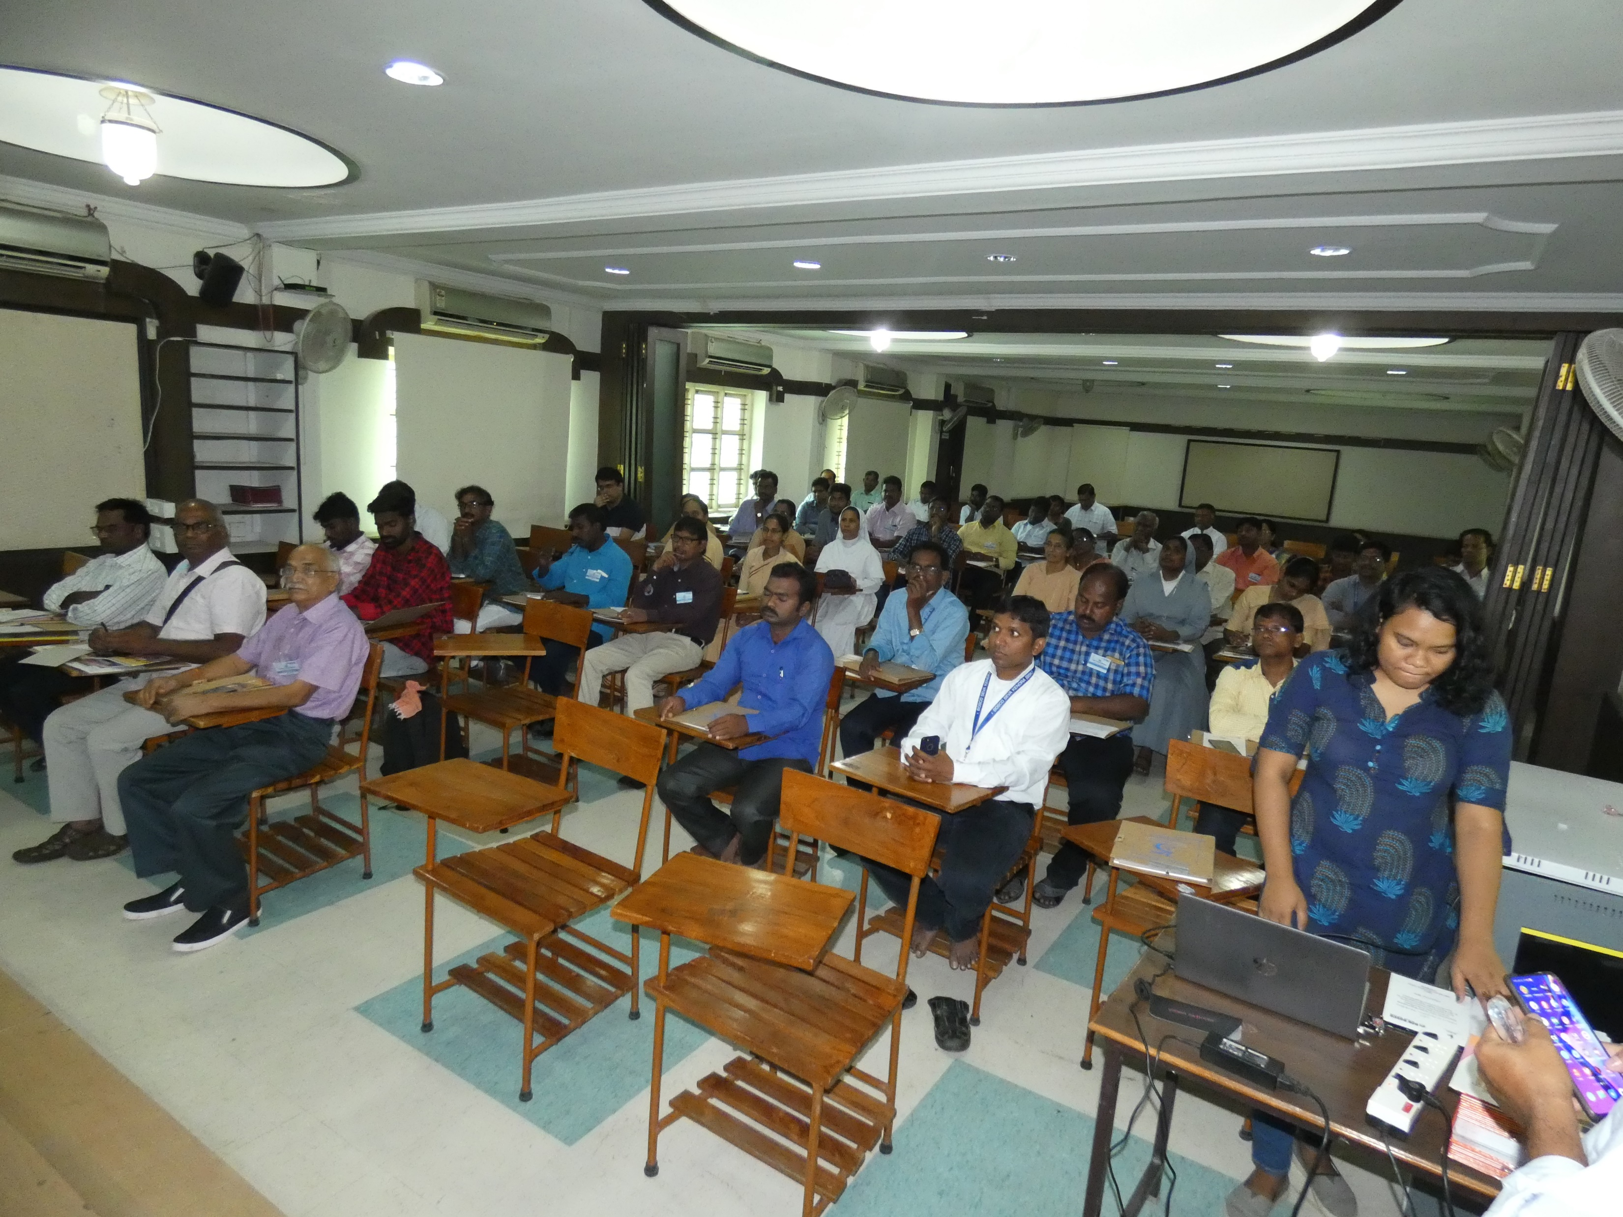
CSO Program
CSO Program
Over the past year and a half, Bosco Seva Kendra with the support of BoscoNet, New Delhi, the National Planning and Development Office for Don Bosco Network, South Asia has launched the Civil Society Organization Program in Andhra Pradesh and Telangana. The Program seeks to build a network of likeminded non-profit organizations or CSOs working collectively to advance environmental conservation, stewardship and economic mobility for poor young people and families. The program provided free training and workshops on Participatory Approach, Lobbying, Negotiations and Government Welfare Schemes.
The goal of these training programs to provide essential tools and resources to develop CSOs working in rural communities, towns and urban centers with the capacity to working with community, civil authorities and community leaders to work collective to improve the quality of life, environmental and opportunities to advance human flourishing. Outlined below are the various training programs undertaken over the past year.
The training programs were undertaken in two phases, the first phase involved training ToTs (Training of Trainers), ToTs serve as Lead Trainers to train CSOs in four regions in Andhra Pradesh and Telangana – Guntur, Ramanthapur (Hyderabad), Ravulapalem and Visakhapatnam. Thanks to the presence of these regional networks for the program, the number of CSOs enrolled in the network has grown to 168 members. Apart from providing training programs and workshops for CSOs, over the past year, the Network has been able to undertaken outreach programs and activities together. During the lockdown, CSOs were able to distribute food kits, face masks and hand sanitizers to migrant labourers and their families stranded in Hyderabad during the lockdown. This outreach program extended to other areas towns and communities in Andhra Pradesh and Telangana.
7

Slide 12
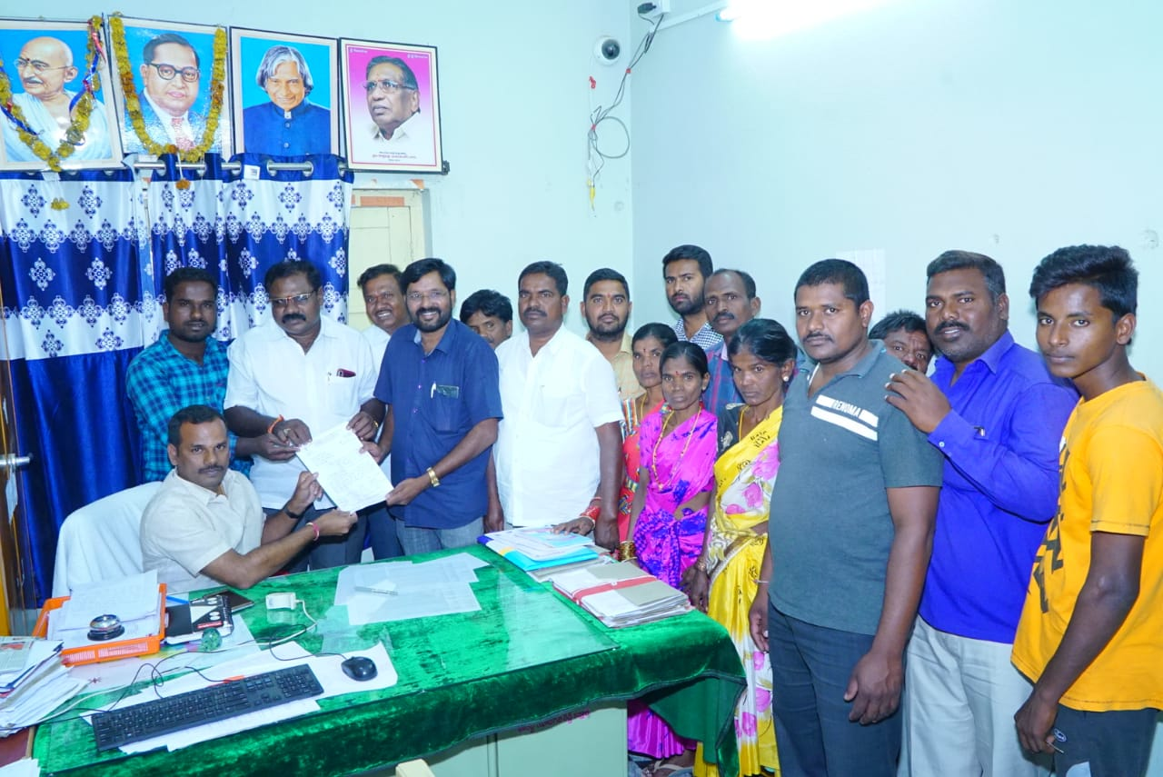
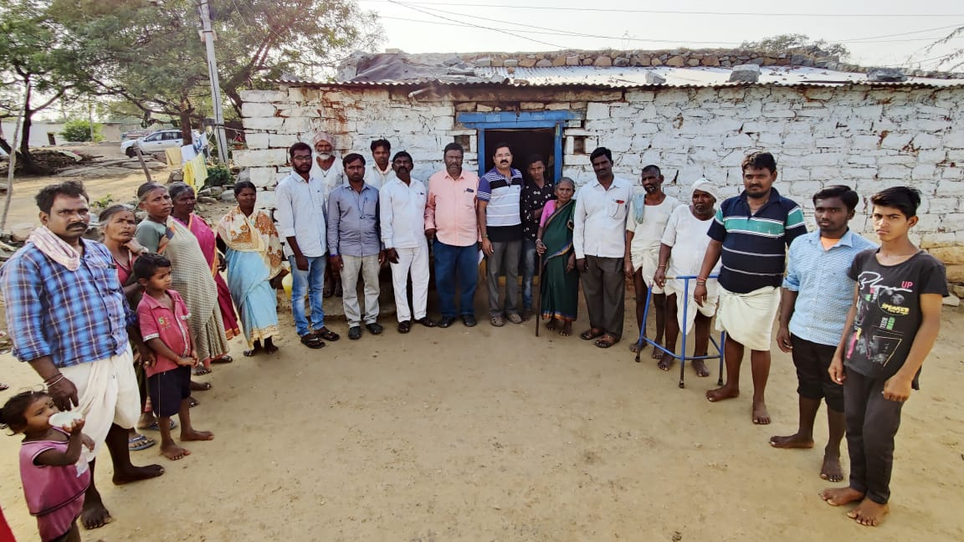
CSO Program
On the left - Submission of Petitions to prevent closures of Government Schools in Telangana, on the right, stakeholder engagement with poor communities.
Profile of CSO Partner
Kommu Thirupathi pictured in the middle is one of the vocal supporters of the CSO Program since its inception in 2019. Kommu Thirupathi has been very active in helping communities in urban and rural areas. He has petitioned the State Government to roll back initiatives that would limit the number of government schools in the state, preventing access to schools for poor children who live in slums. He has campaigned to prevent mining of uranium in rural Andhra Pradesh and Telangana, which can damage and destroy essential underground water reserves essential for the welfare of poor farmers, families and rural communities. He has also campaigned for the welfare of poor families who are suffering due to challenges of farming in India, extreme climate and limited economic opportunity.
DBTech
DBTech provide free short term training programs in tailoring, hospitality, motor mechanics, data entry, electricals, sales, ecommerce fulfilment, etc. for poor youth and young people across India. Bosco Seva Kendra is responsible for the implementation of the program in Andhra Pradesh and Telangana. DB Tech has partnered with local non-profit organizations, the State Government of Andhra Pradesh, and the regulatory authority of the ‘National Skill Qualifications Framework’ of the Government of India to provide short term training programs for students enrolled in 48 government schools in Andhra Pradesh.
8

Slide 13
DBTech – Skill Training and Job Placement
DBTech programs are also operational in six Don Bosco Institutions located in Ongole, Viskahapatnam, Guntur, Karunapuram, Gagillapuram and Warangal. In total over 220 students are receiving free skill training thanks to donors who have sponsored this program. Students who complete their three to six month training program are provided with job placement services who DB Tech and DHISHA, the job placement and careers office of BSK. Outlined below are success stories of recent graduates from the program. Despite the challenges of an ongoing economic recession, we have been able to provide job opportunities to young people.
Success Story I
Vasu Yedakula graduated from the hospitality program organized by DB Tech, at Don Bosco Navajeevan, Sabbavaram, Visakhapatnam. The center is a residential home and skill training center for poor youth, Don Bosco Navajeevan, Sabbavaram, is located outside the city of Visakhapatnam and has for the past several years been organizing DB Tech programs for poor youth and young people from Andhra Pradesh. Vasu comes from a rural village in Chodawaram, and told our instructors and administrators at DB Tech, Sabbavaram that there were limited to no opportunities for young people in his village to get a job and to support their parents. The vast majority of families are poor and sustain themselves through subsistence farming and small businesses. Thanks to his enrolment in the hospitality program, Vasu is earning Rs. 8,000 a month with free accommodation, food and a state pension program at a premier hotel in Nellore, Andhra Pradesh. He is grateful for the efforts of DBTech and their donors to provide such skill training programs for young people.
Success Story II
Mohan Silarapu comes from a small community just outside of Visakhapatnam called Kothavalasa. Both his parents are daily wage labourers and his siblings reside in various village communities in the area. Due to the various financial hardships Mohan’s family was facing at home, he intended to find a good job to be better positioned to support himself and his parents. Mohan learnt about the free training programs offered by DB Tech for poor youth. He enrolled in the hospitality training program at Don Bosco Navajeevan, Sabbavaram. Today, Mohan earns Rs. 9,000 a month as a chef in a restaurant in Visakhapatnam. The restaurant provides Mohan with added benefits such as free food, housing and a state pension program. Mohan is deeply appreciative of the support he has received from the program and is grateful to have been given such an opportunity to support himself and someday his parents.
9

Slide 14
DBTech – Skill Training and Job Placement
Outline of Training Programs and Job Placement
The table below concerns the various training programs undertaken by DBTech in the state of Andhra Pradesh and Telangana. The main skill training programs were sales, hospitality and electricians. In total, 432 students graduated from the program, which lasts three months. Around 66% of students received job offers despite the pandemic. Some of the programs has to suspend operations for a period of 6 months due to the ongoing pandemic.
With restrictions lifted towards middle of 2020, DBTech has been fortunate to continue providing skill training programs for poor youth and young people in Andhra Pradesh and Telangana. Despite the pandemic and a downturn in the economy, employers are interested in working with our organization to hire graduates from the program.
Program | Location | Launch | Graduation | Target | Enrolled | Graduated | Job Offers
Food and Beverage Service-Steward | Ongole | 31/12/2019 | 29/03/2020 | 30 | 26 | 26 | 15
Automotive Service Technician Level 4 | Ongole | 31/12/2019 | 29/03/2020 | 30 | 26 | 25 | 18
Food and Beverage Service-Steward | Ongole | 06-01-2020 | 29/08/2020 | 30 | 24 | 24 | 20
Food and Beverage Service-Steward | Guntur | 11-02-2019 | 30/01/2020 | 30 | 30 | 26 | 26
CRM Domestic Non Voice | Guntur | 18/01/2020 | 16/04/2020 | 30 | 25 | 25 | 21
Food and Beverage Service-Steward | Guntur | 22/02/2020 | 21/05/2020 | 30 | 25 | 25 | 19
CRM Domestic Non Voice | Guntur | 06-01-2020 | 29/08/2020 | 30 | 25 | 25 | 20
Food and Beverage Service-Steward | Sabbavaram | 23/12/2019 | 21/03/2020 | 30 | 30 | 30 | 24
Helper Electrician | Sabbavaram | 26/12/2019 | 24/03/2020 | 30 | 31 | 31 | 22
Food and Beverage Service-Steward | Sabbavaram | 06-01-2020 | 29/08/2020 | 30 | 35 | 35 | 29
Food and Beverage Service-Steward | Gagillapuram | 20/01/2020 | 18/04/2020 | 30 | 25 | 25 | 24
Helper Electrician | Gagillapuram | 27/02/2020 | 26/05/2020 | 30 | 25 | 25 | -
Food and Beverage Service-Steward | Gagillapuram | 06-01-2020 | 29/08/2020 | 30 | 25 | 25 | 25
Food and Beverage Service-Steward | Karunapuram | 30-12-2019 | 28-03-2020 | 30 | 30 | 30 | 15
Sales Associate | Karunapuram | 30-12-2019 | 28-03-2020 | 30 | 30 | 30 | -
Food and Beverage Service-Steward | Karunapuram | 06-01-2020 | 29-08-2020 | 30 | 25 | 25 | 5
TOTAL |  |  |  |  |  | 432 | 283
Job Placement Rate |  |  |  |  |  | 66%
10

Slide 15
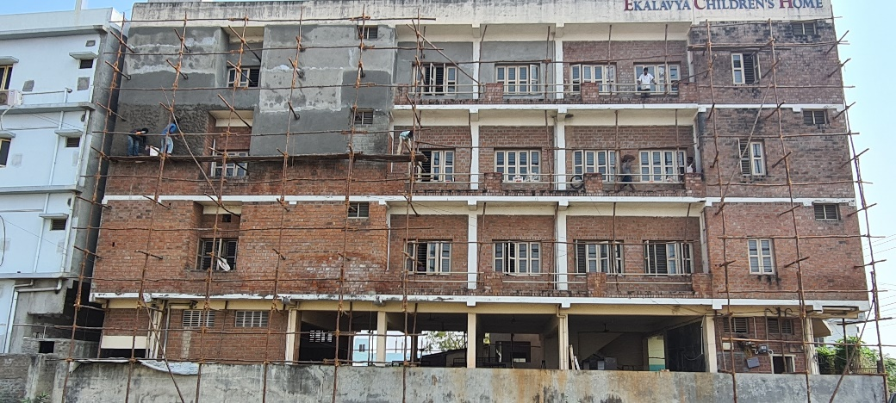
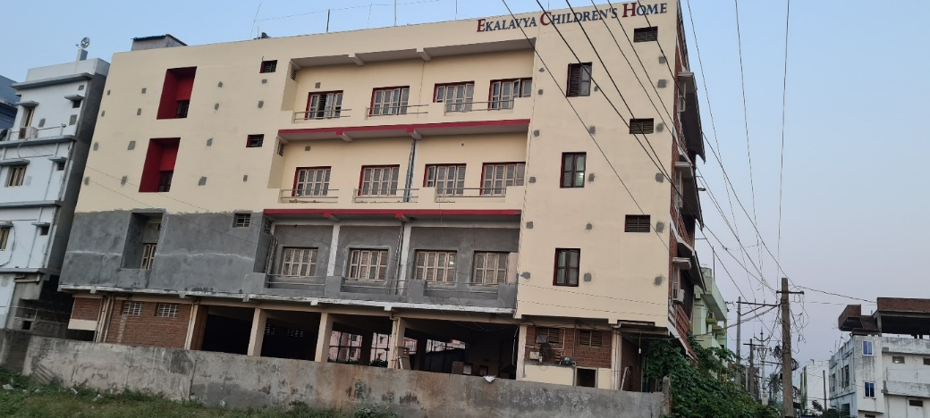
Homes for Abandoned Children
One of the core pillars of our organization is our institutional capacity to provide child care services and access to institutions that rehabilitate and care for children from broken homes, orphans, poor single parent households and those found abandoned on the street. Over the past 4 decades our organization has pioneered the development of Navajeevans, homes that rescue and rehabilitate abandoned children and youth from broken homes. We operate a network of such homes in Hyderabad, Vijayawada, Kurnool, Warangal, Vishakhapatnam and Rajahmundry. Close to 1,200+ children directly benefit from this institutional network. This year we were fortunate to have received support from a major donor to renovate one of these centers.
Renovations of Ekalavya Children's Home, Rajahmundry, Andhra Pradesh
Ekalavya Children's Home was established in 2014 to provide rehabilitation and child care services for children from broken homes, poor households and single parent homes. The campus is located in Rajahmundry, where staff members and directors work closely with the police, state social workers and various non-profits to provide an alternative to children living and begging on the street, or those suffering in broken homes. At present the center houses 35 children who are enrolled in government schools in the area and are provided with free housing, food and community to help them grow and develop as dignified human beings. This past year the center was grateful for the efforts of donors to provide financial assistance to renovate the campus and provide better residential facilities for children and staff who reside at this campus. As of February, 2020, the significant renovation works were completed, the center is on the lookout for donors to complete the remaining renovation works. Pictured below are the renovations works that were undertaken, followed by success stories of children who have benefited from our outreach and services.
11

Slide 16
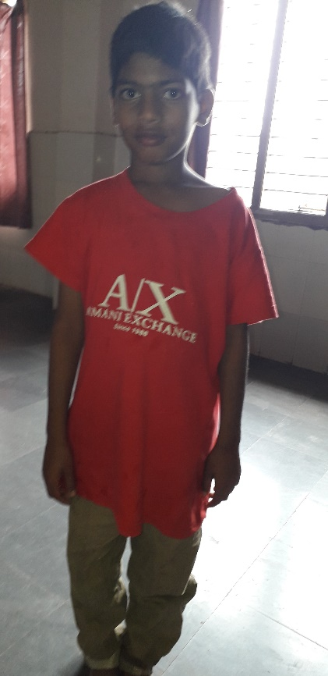
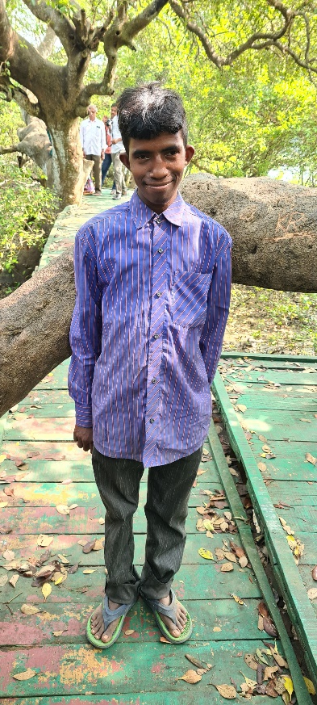
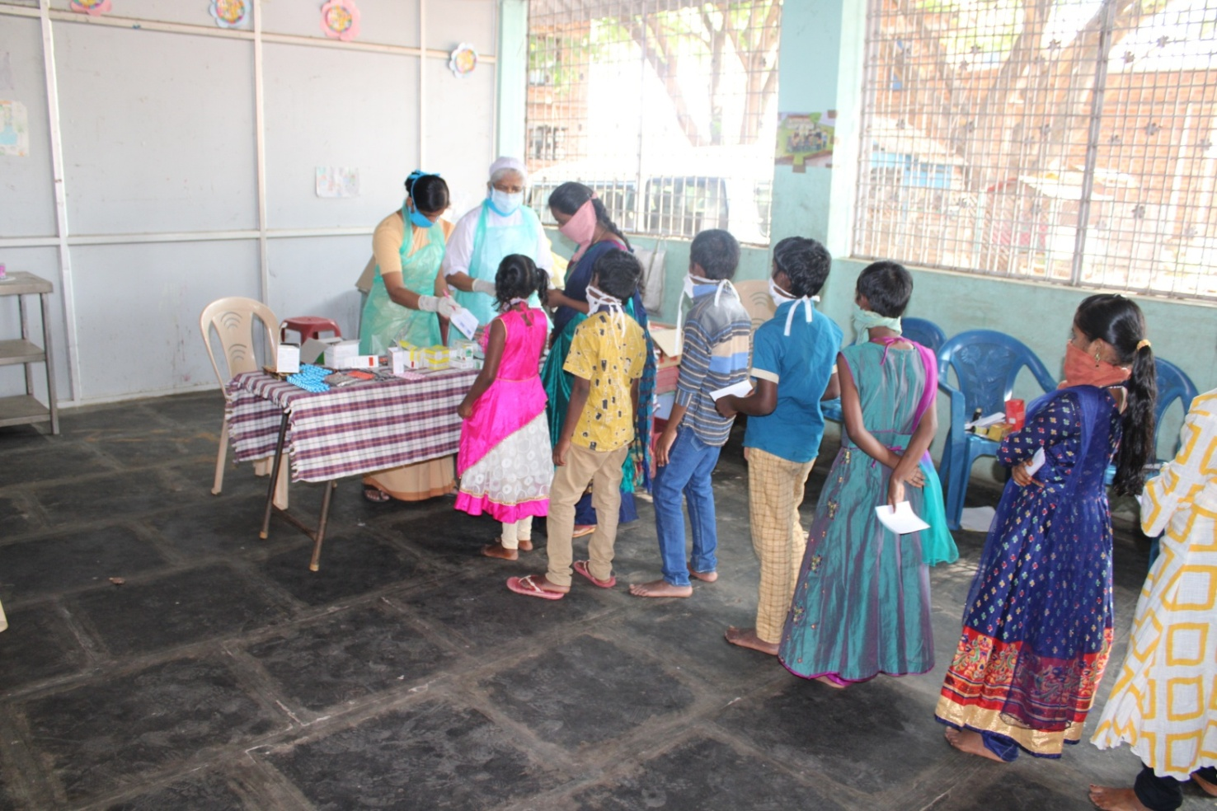
Homes for Abandoned Children
Success Stories of Ekalavya Children’s Home
Name of the Child: Rajesh, 9 Years Old
A grassroots non-profit organization associated with our organization found Rajesh begging at the railway station in Rajahmundry and brought him to our center. The boy came from a broken home, his father had left his mom, and was with another woman. His mother was in poor health and was not in a capacity to support her son. Thanks to our efforts, we were able to bring the child to his father, but his father claimed that the boy stole money from him and ran away from home, he refused to take legal custody of his son. Today, Rajesh is enrolled in a government school, lives with us on our campus and is an active member of our community.
Name of the Child: Durgaprasad, 18 Years Old
Sankumala was brought to our center thanks to the efforts of CWC staff (Child Welfare Committee) who operate on our premises. Staff members of our organization reached out to Sankumala’s mother who was living in a small rented home and begs on the street every day. She requested our organization to take care of him. A few months later we learnt that Sankumala’s mother met with an accident and had sadly passed away. We were able to file a court case against the truck driver who was responsible for her death, and was able to receive some form of financial compensation. We have deposited this money into Sankumala’s bank account which he can utilize when he grows up.
COVID-19, Street Children and our Navajeevan Network
COVID-19 will increase the number of orphaned and abandoned children in the coming years. We expect to see an increase in poverty and a generation of students who have are behind their peers in terms of academic formation. Our organization has been able to conduct outreach programs where we have provided free testing to poor children who could be affected with COVID-19, conducted health camps with Government Hospitals and Clinics, and continued operating our homes despite the lockdowns and various uncertainties. The points below are the key organizational changes we have implemented this year. On the left is a COVID-19 testing program in one our centers in Vijayawada.
Online learning for students and youth in our homes
No visitors into our institutions to prevent the spread of the virus
Adoption of all health and safe precautions
12

Slide 17
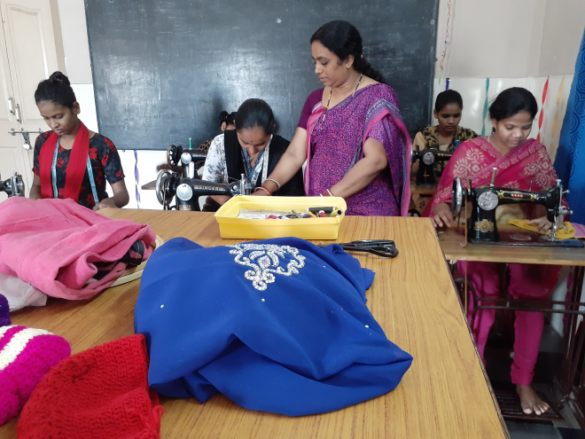
Safe Homes for Women and Advancing Economic Mobility for Women
Skill Training for Poor Mothers – Surakshitha, Ravulapalem
In 2021, our organization with the support of BoscoNet was grateful to have received financial support from a major donor to provide skill training programs for 50 poor mothers and women, who are victims of domestic violence and come from poor households. These women belong to Surakshitha, a safe home and pregnancy center for poor women in Ravulapalem, Andhra Pradesh. Over a period of 6 months, these women were trained to tailor clothes and do embroidery work. The goal of this project was to ensure that these women can earn a side income and support their households. Pictured on the bottom left is the skill training program being undertaken at this center.
Beautician Program – Don Bosco Human Resource Development Center, Gagillapur
This year, we welcomed a new major donor to support skill training of poor youth at Don Bosco Human Resource Development Center, Gagillapur. The donor helped and establish a new beauty parlour to train poor girls from rural and urban areas, girls rehabilitated by safe homes in Hyderabad and the rest of our region. Due to high urbanization in our region job opportunities are there for youth in the beauty and wellness industry. Apart from the beautician program, this center has received financial assistance to improve programs for tailoring and campus facilities to house students residing at this center. Don Bosco Human Resource Development Center was established in 2008 and provide short term skill programs on an integrated campus. The campus has housing facilities for students and certain staff members. The center has partnerships with various businesses in the area to recruit graduates.
13

Slide 18
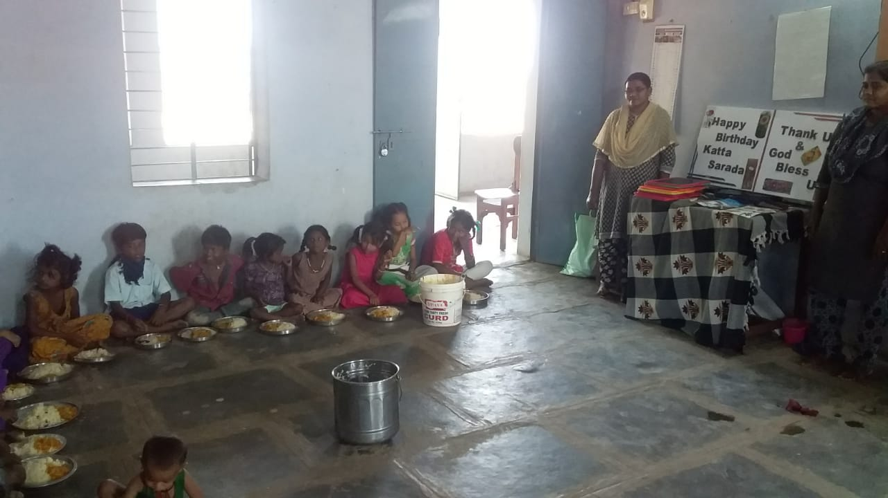
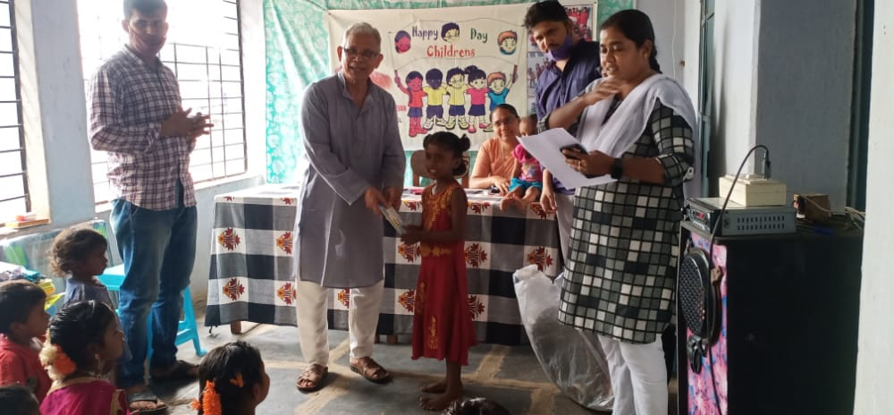
Shikari Project
Pictured above is the Meal Program and Activities for Children – Shikari Program, Kurnool, Andhra Pradesh
Shikari Project
For the past few years our organization has been involved in helping reduce child neglect among the Shikari Community residing in various slum areas in Kurnool, Andhra Pradesh. The Shikari are a tribal community from Central India that have migrated to Kurnool and other parts of the region in search of better job opportunities. Due to extreme poverty, high illiteracy and language barriers, this community has to fight for survival. Our organization supports Don Bosco Navajeevan, Kurnool, a home for street children that provide meals, primary healthcare and residential care for children who are abandoned or orphaned. Children residing in this center are registered with the local police and have been transferred to the center under the jurisdiction of CWC (Child Welfare Committee).
This center has been responsible for reaching out to these families of the Shikari Community and providing their children with access to meals cooked in our center, conducting programs and enrolling them into government schools in the area. Photographed below are the activities that we have been conducted over the past year in this program. One of the major changes we have noticed is that we have managed to reduce child neglect, and students have been able to continue their education despite the pandemic and the transition towards online education.
14

Slide 19
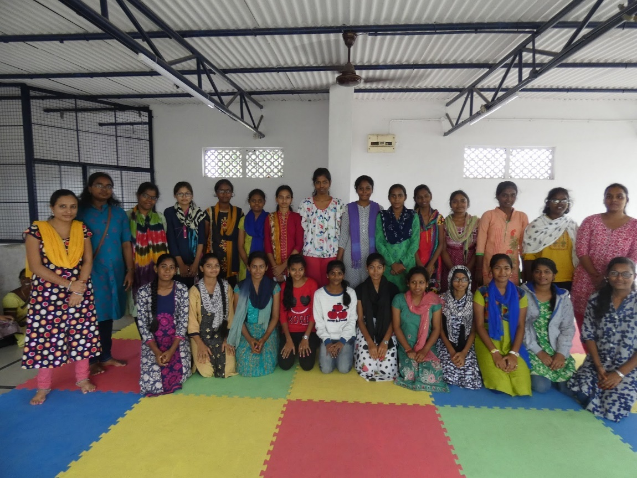
Kiran Anjali Program
Kiran Anjali Project
For the past 2 years our organization has partnered with the Kiran Anjali Project to provide educational opportunities in terms of scholarships to deserving poor girls in Hyderabad. This year 25 girls received scholarships thanks to the support of this organization and their donors. Girls in our region are denied opportunities to complete their grade school education, pursue higher education and professional careers due to poverty and limited parental support. This program ensures that such girls have such opportunities, access to a mentor and support to enjoy this time in their lives and aspire to become the best version of themselves.
Pictured above are the beneficiaries of this program, girls who benefit from this program meet with their mentors regularly and participate in group activities to build a sense of solidarity and friendship among themselves. Every few months, staff members who serve as mentor organize community activities, games and programs to celebrate the local festivals during the year. In India due to various social problems, there is a major disparity between the literacy rates of girls and men. This program is a small step towards addressing this issue.
15

Slide 20
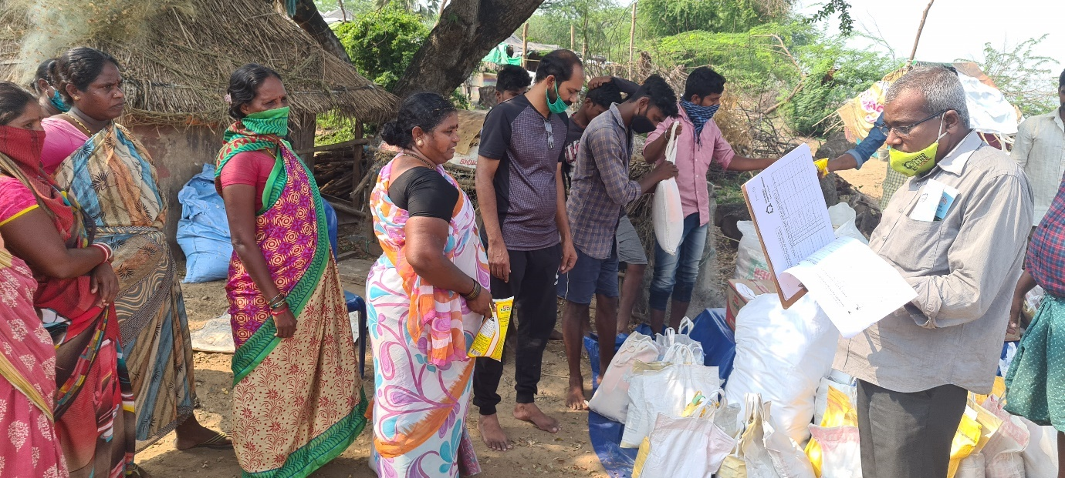
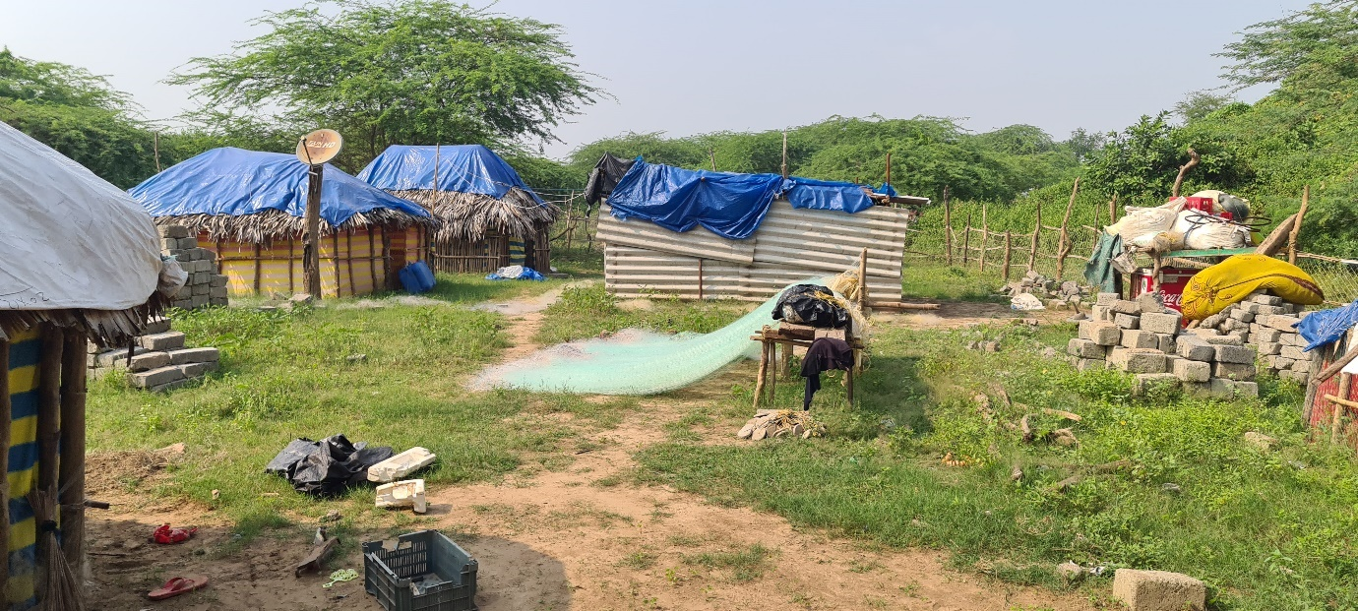
Flood Relief – Andhra Pradesh and Telangana
Flood Relief – Andhra Pradesh and Telangana
In August 2020, in Andhra Pradesh especially Godavari District and other parts of this region were severely devastated with heavy rains and floods. Thousands of families were forced to evacuate from their villages, and move to higher grounds. Our organization is active in this region and was acutely aware of the challenges families were facing. We were able to distribute food and relief packages to over 800 families who were affected by the floods. Our organized packaged various food items consisting of grains and other essentials that can feed a family of four for two weeks, along with basic health essentials such as hand sanitizer, masks and multi vitamins. Pictured above are the beneficiaries of this program, we are deeply grateful to our donors for supporting this relief effort.
Summary and Conclusion
In spite of an ongoing pandemic, our organization was able to grow opportunities for skill training programs with the help of donors, undertake significant outreach to support poor families and migrants afflicted by the economic fallout of COVID-19. In the coming months and years ahead, our organization will continue to face various uncertainties as we navigate the challenges that lie ahead, despite such unknowns we will continue to be of service to the people, communities and institutions we have been entrusted too.
16

